Slide 1
18 participants
Notes:
Analysis:
1. check accoridng to whetehr response itself was repeated ornot repeated for each type of two target trial (collapsing across all 2 target trial types, and with the 1 target trial type )
3. Separate out the response trials wrt to whether the same response or diff response (e.g., cong/cong trials, whether same response as this trial or different response)

Slide 2
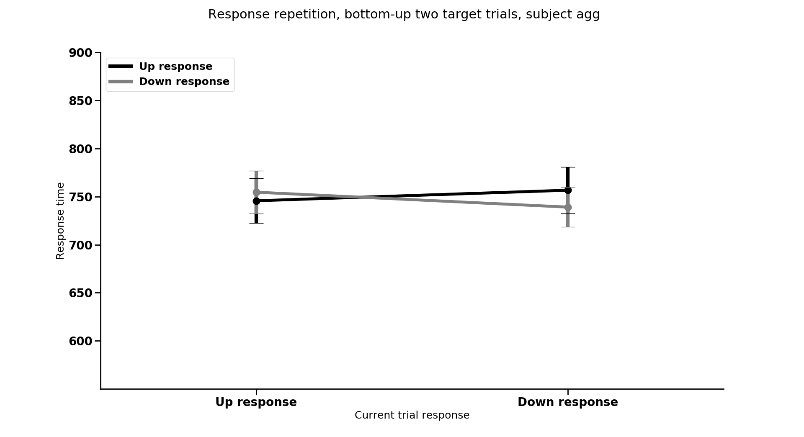
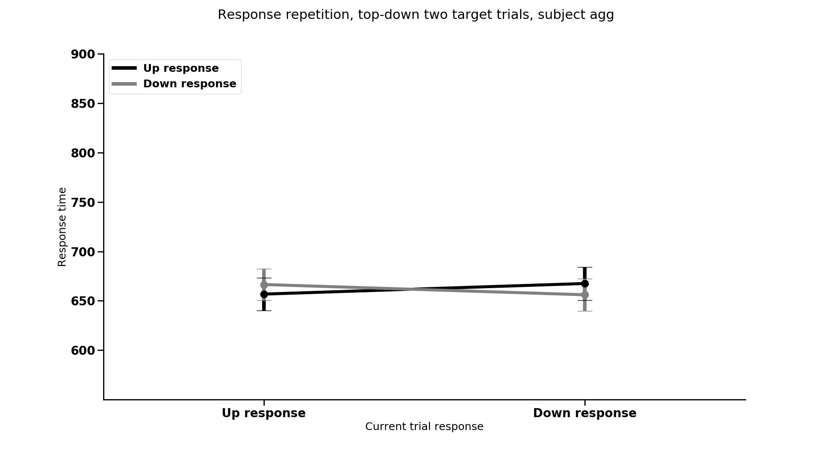
Response repetition
Current response

Slide 3
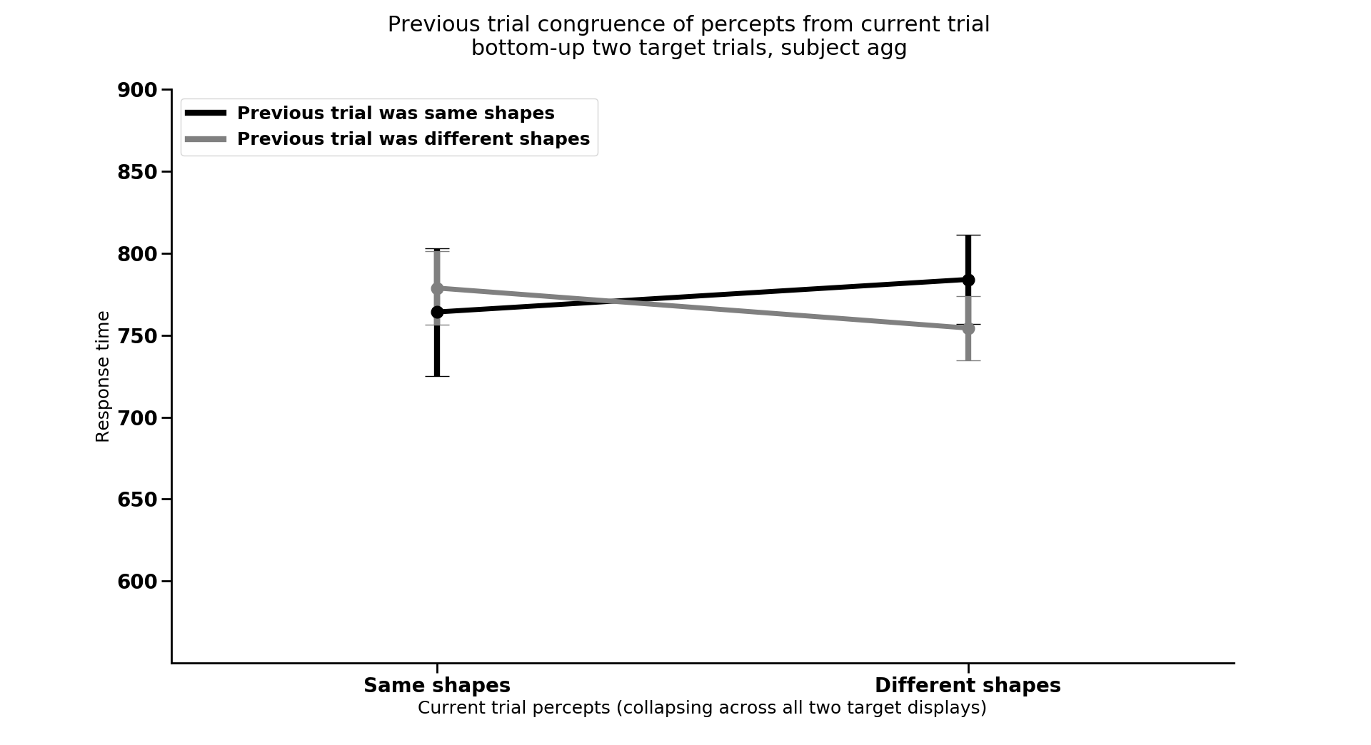
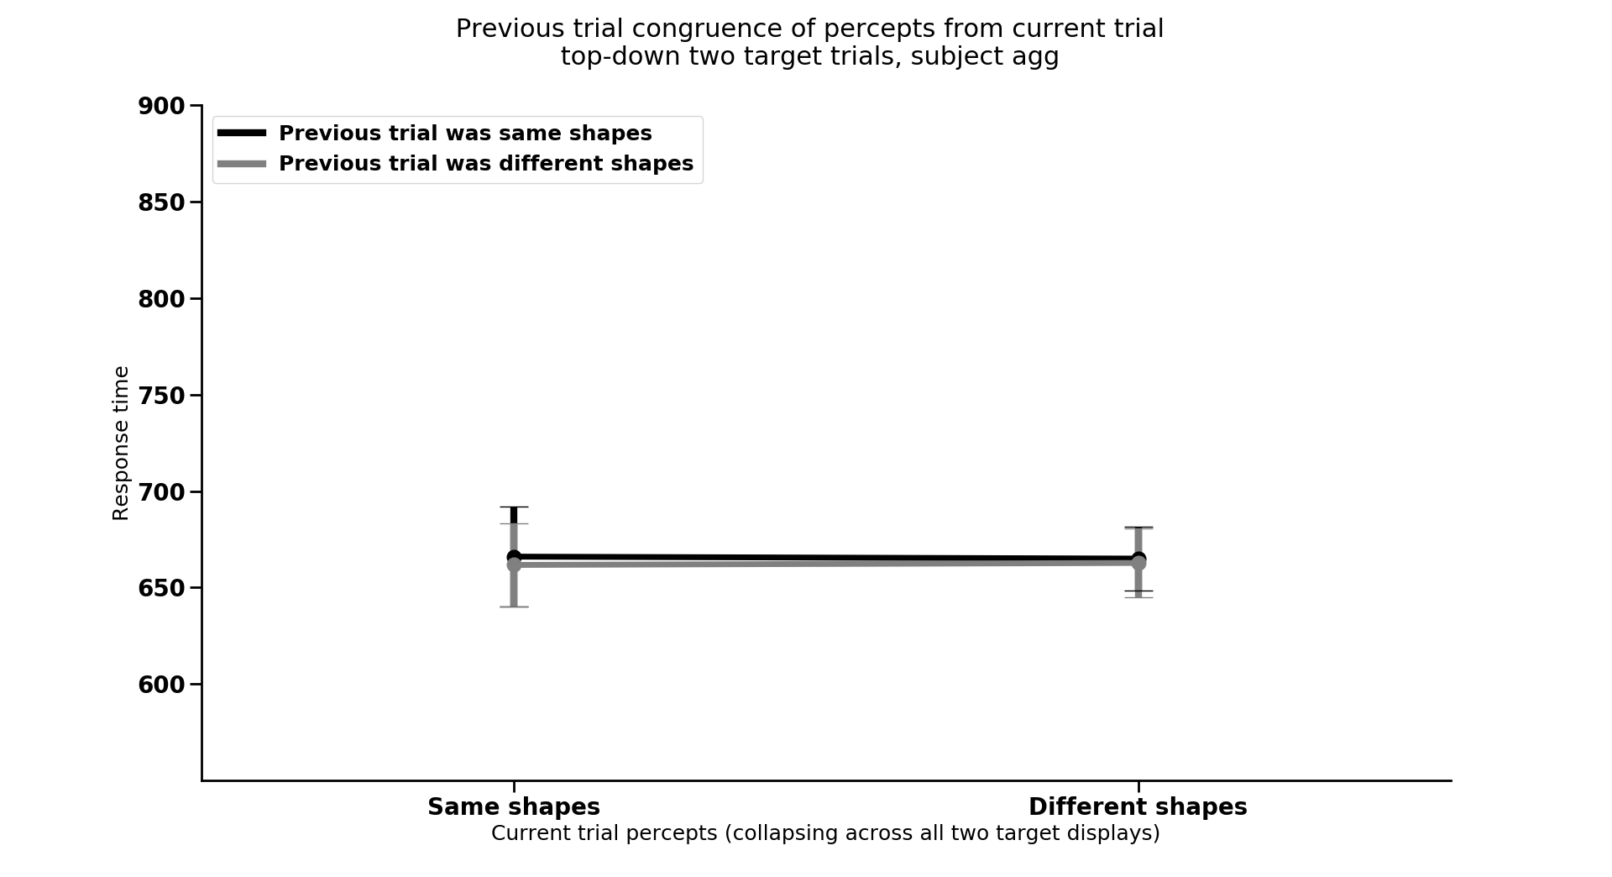
Previous trial type by congruence of shape compatibility,
collapsing across each specific trial type
Current trial shape compatibility
Notes:
2. Gratton effect analysis (switching between congruent previous vs. incongruent previous trial) sequence effects

Slide 4
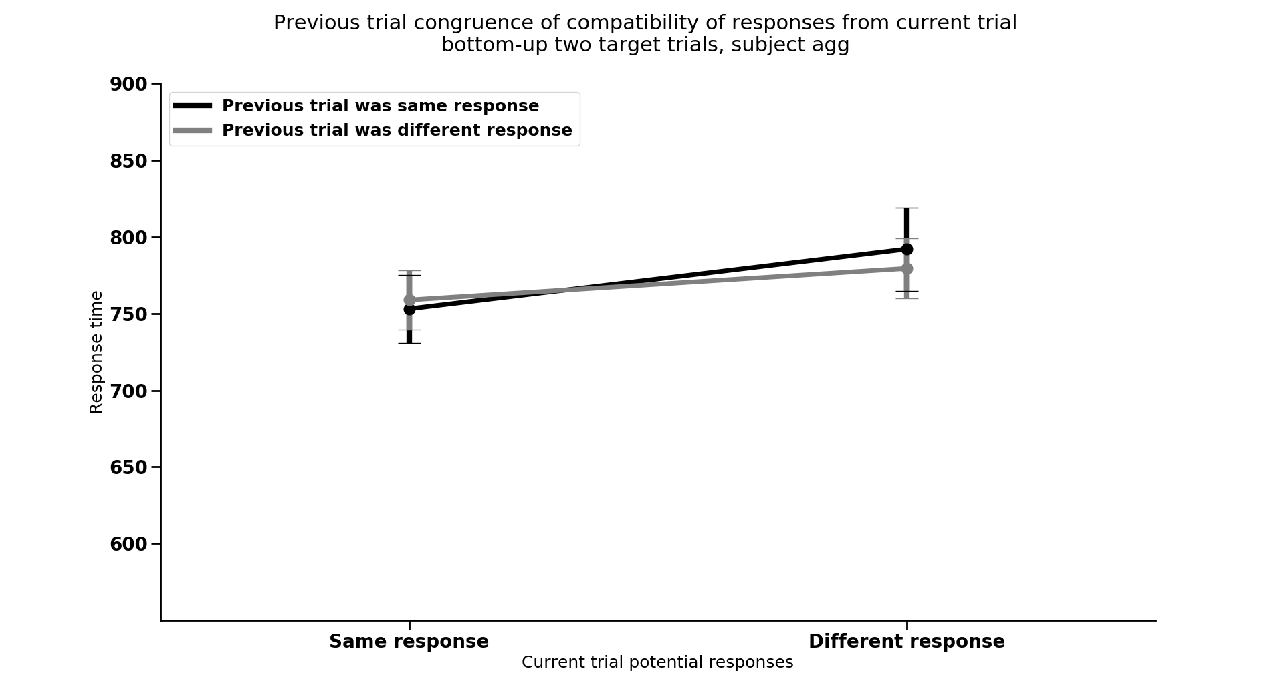
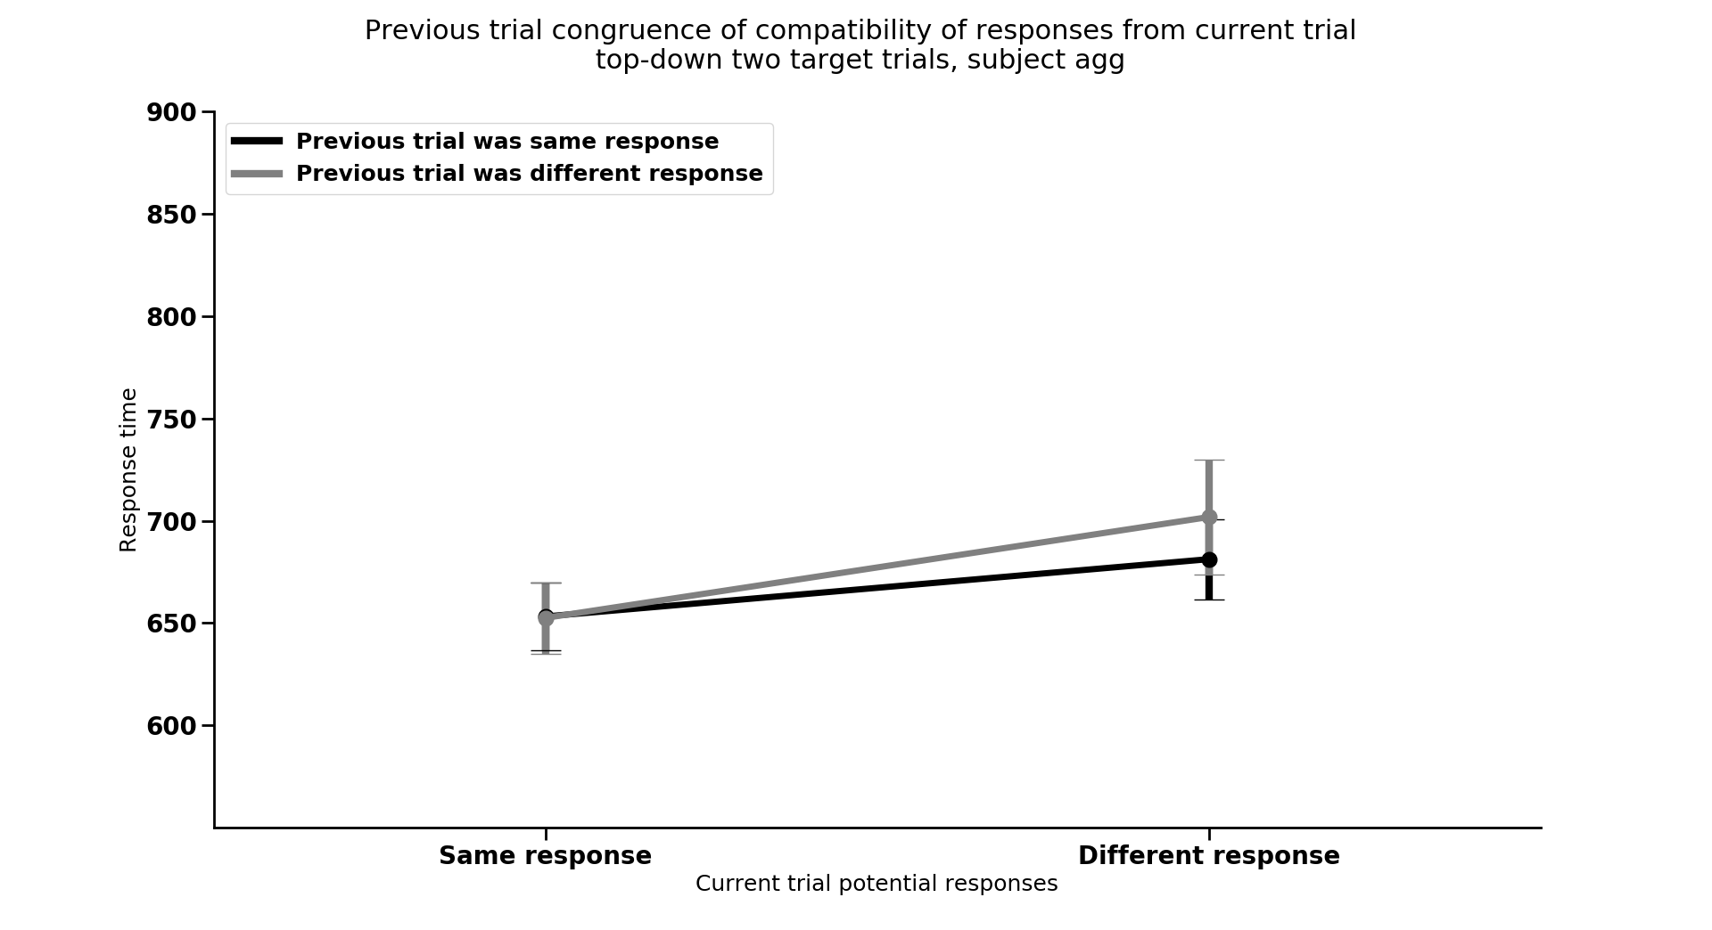
Previous trial type by congruence of response compatibility,
collapsing across each specific trial type
Current trial response compatibility
Notes:
2. Gratton effect analysis (switching between congruent previous vs. incongruent previous trial) sequence effects

Slide 5
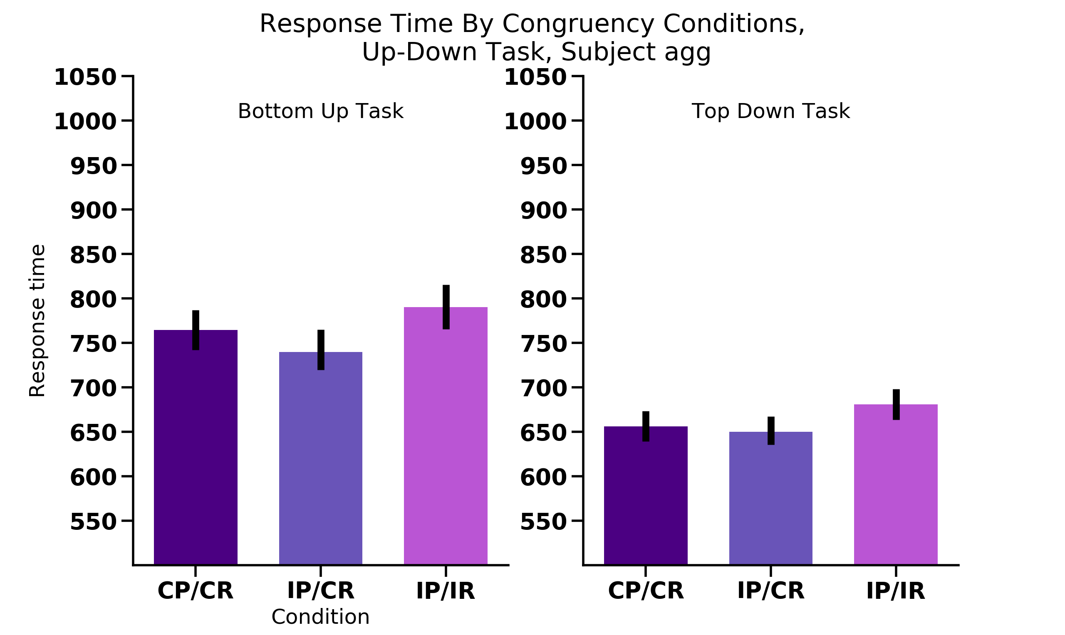
Percept
Response
UP
UP
UP
UP
UP
DOWN
UP
UP
UP
UP
UP
DOWN
N = 18

Slide 6
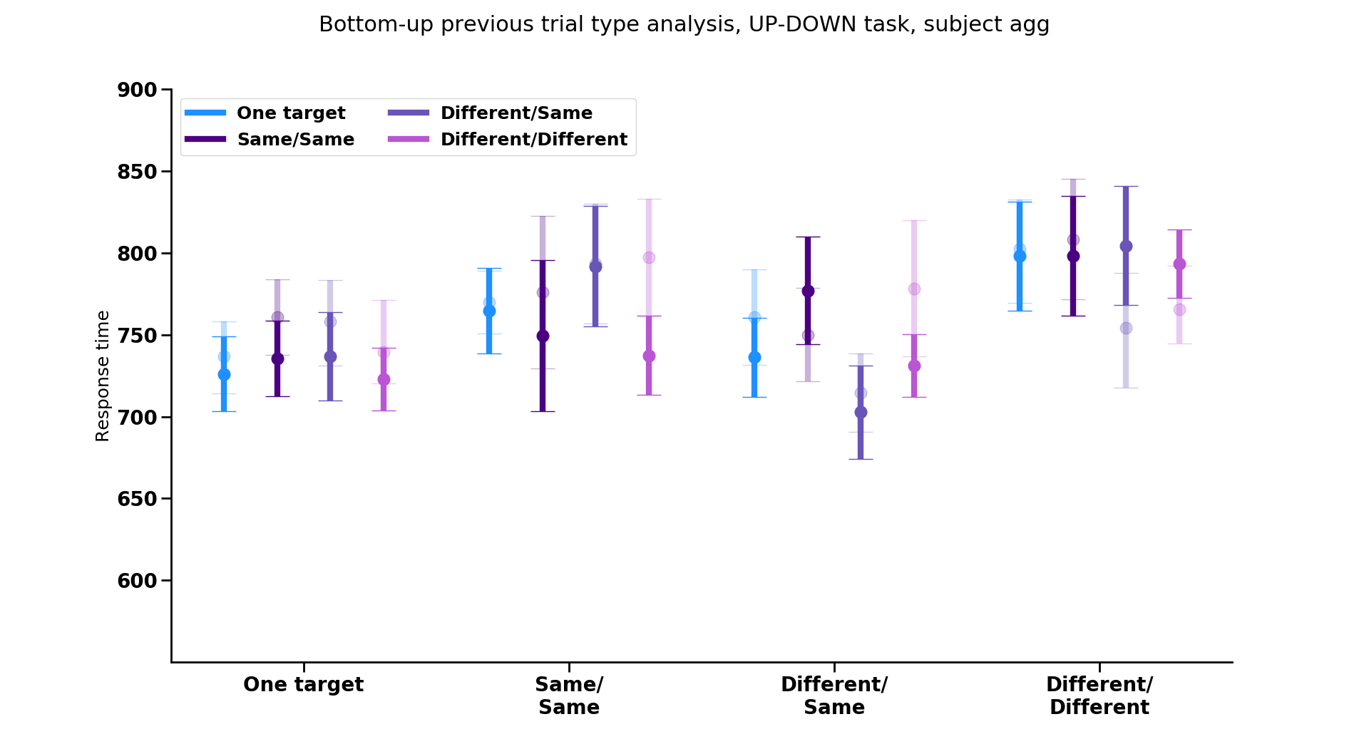
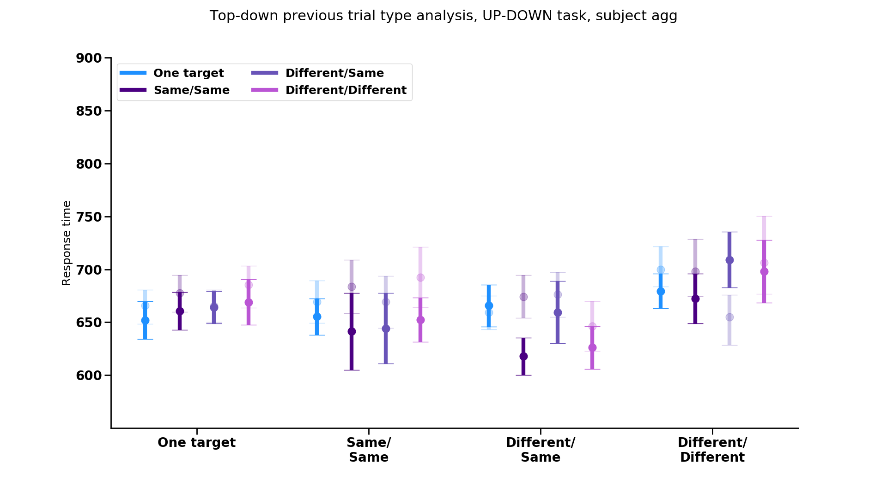
Previous trial type by response repetition
Repeated resp.
Switched resp.
Previous trial
Previous trial
One target
Same/Same
Different/Same
Different/Different
One target
Same/Same
Different/Same
Different/Different
Current trial
Notes:
** SOME PARTICIPANTS DO NOT HAVE ANY TRIALS THAT FIT INTO THESE CATEGORIES (i.e., some participants always answered wrong on the small number of trials [~2-10] and thus don’t have a mean to use here)
Verify bernhard hommel prior coding idea is right, if so what would be the best graph to show it
Think about what to do if not talking about the previous trial stuff

Slide 7
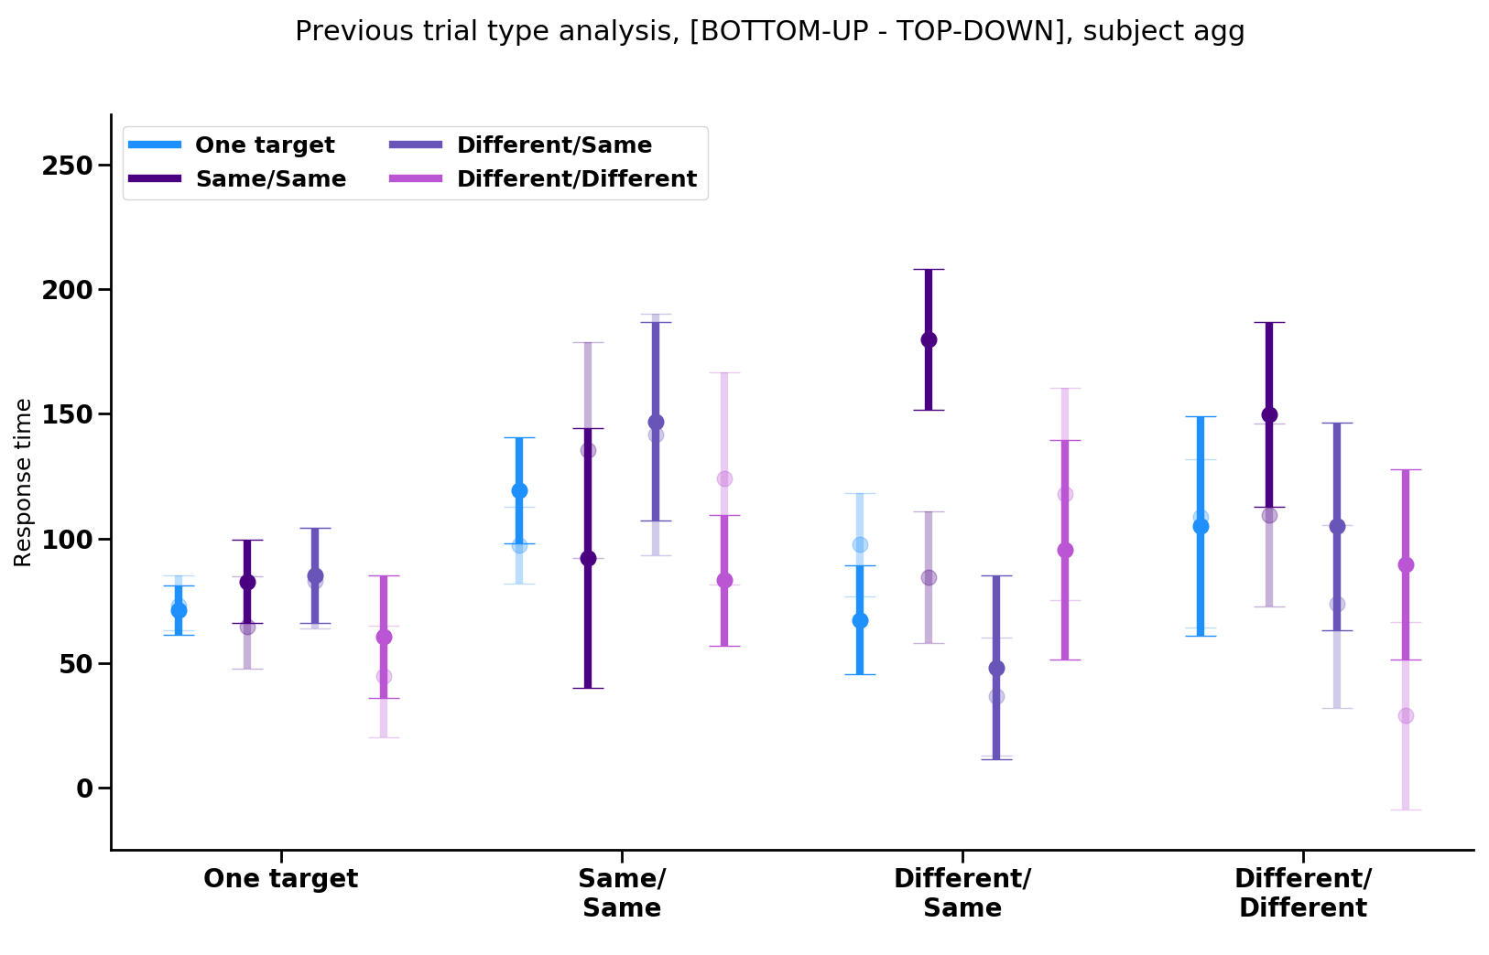
Previous trial
Repeated resp.
Switched resp.
One target
Same/Same
Different/Same
Different/Different
Current trial
Notes:
** SOME PARTICIPANTS DO NOT HAVE ANY TRIALS THAT FIT INTO THESE CATEGORIES (i.e., some participants always answered wrong on the small number of trials [~2-10] and thus don’t have a mean to use here)
This is the mean difference between BU rt and TD rt for each subject for each condition, with BS SEMS of the mean differences
Idea is to see what exists in the bottom-up data that isn’t in the top-down data by subtracting the top-down as if it were baseline

Slide 8
Previous trial type analysis, Exps. 1-2

Slide 9
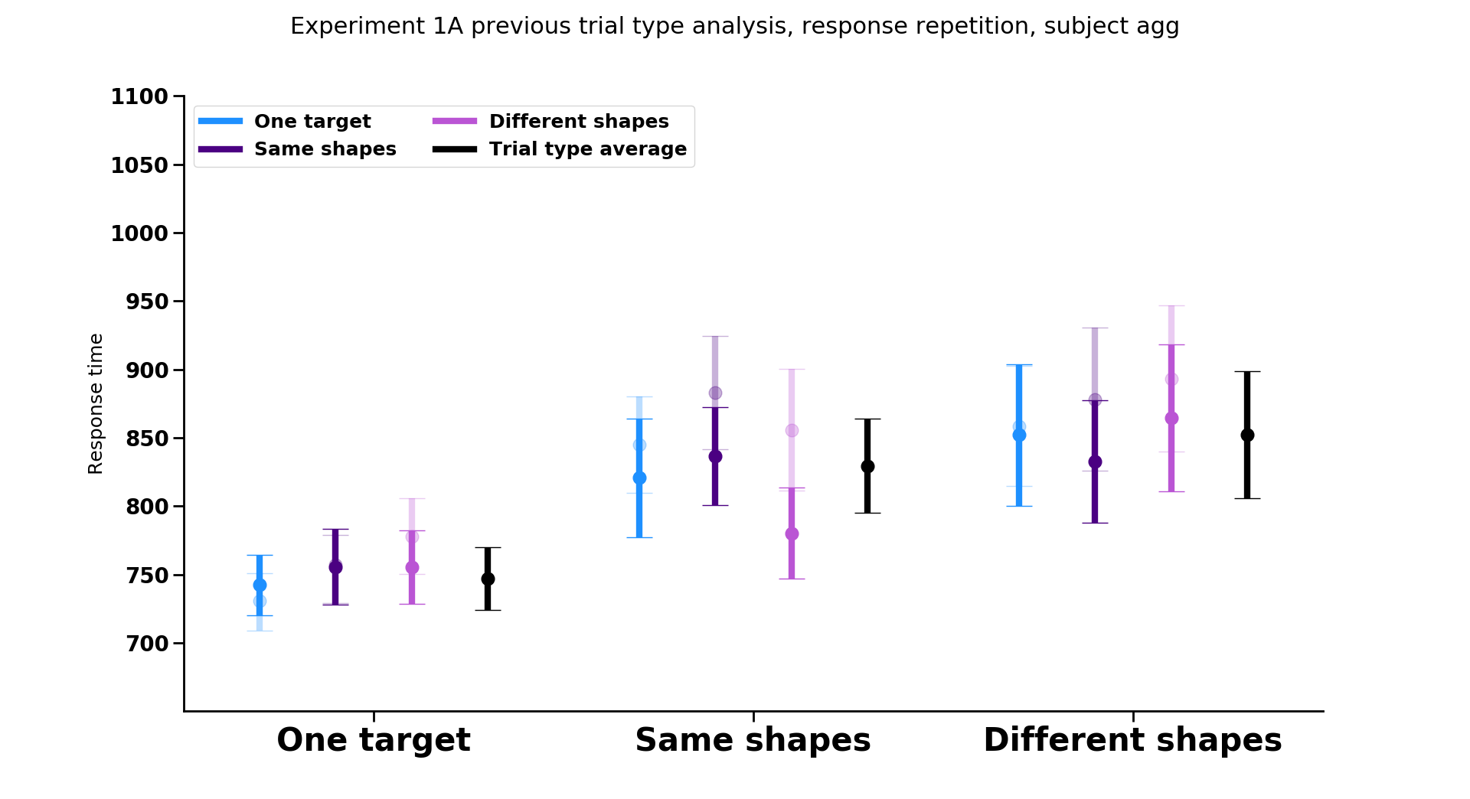
Previous trial
Repeated resp.
Switched resp.
Current trial

Slide 10
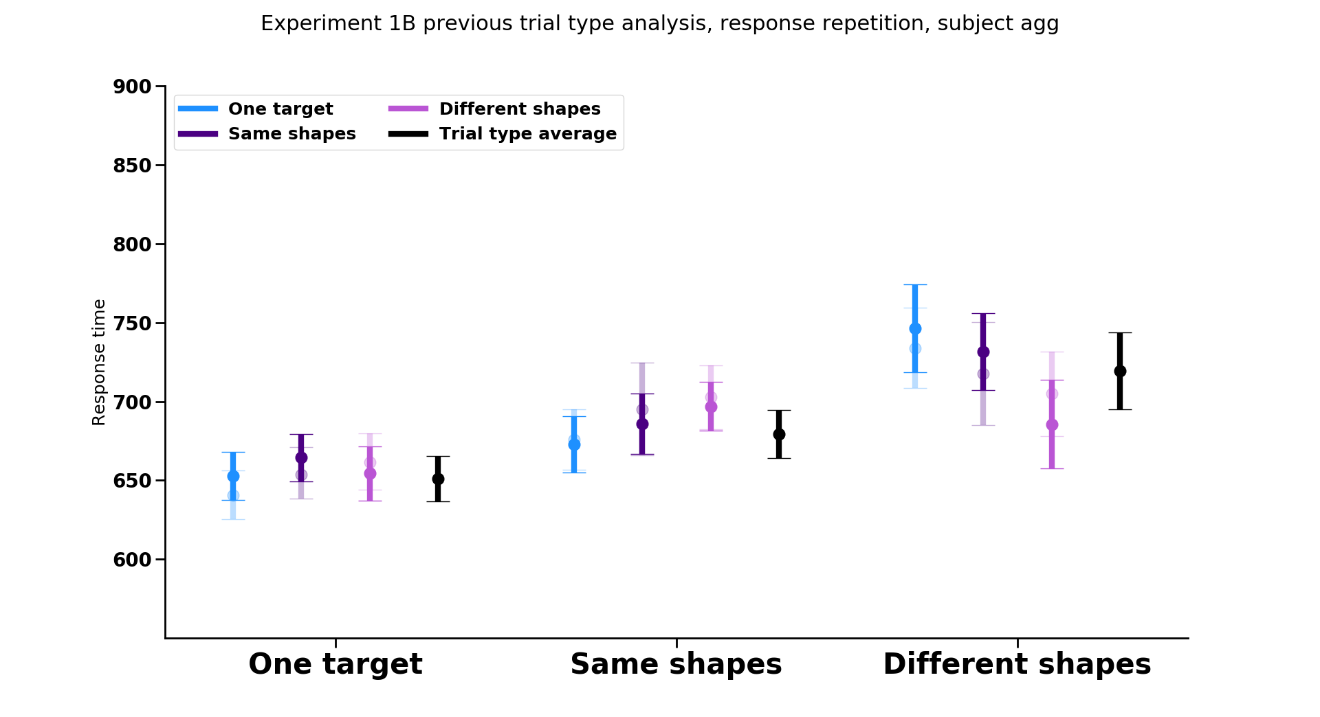
Previous trial
Repeated resp.
Switched resp.
Current trial

Slide 11
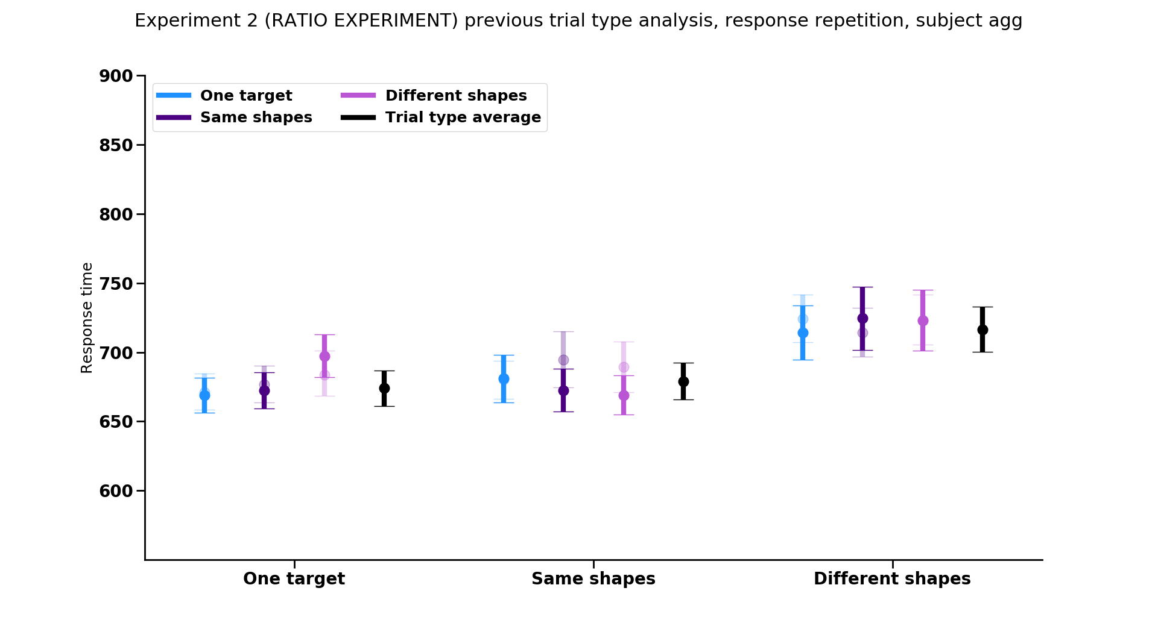
Previous trial
Repeated resp.
Switched resp.
Current trial

Slide 12
Repeated resp.
Switched resp.
Notes:
Trend: response repetition matters when the current trial has same responses (in exps 1A and 2)

Slide 13
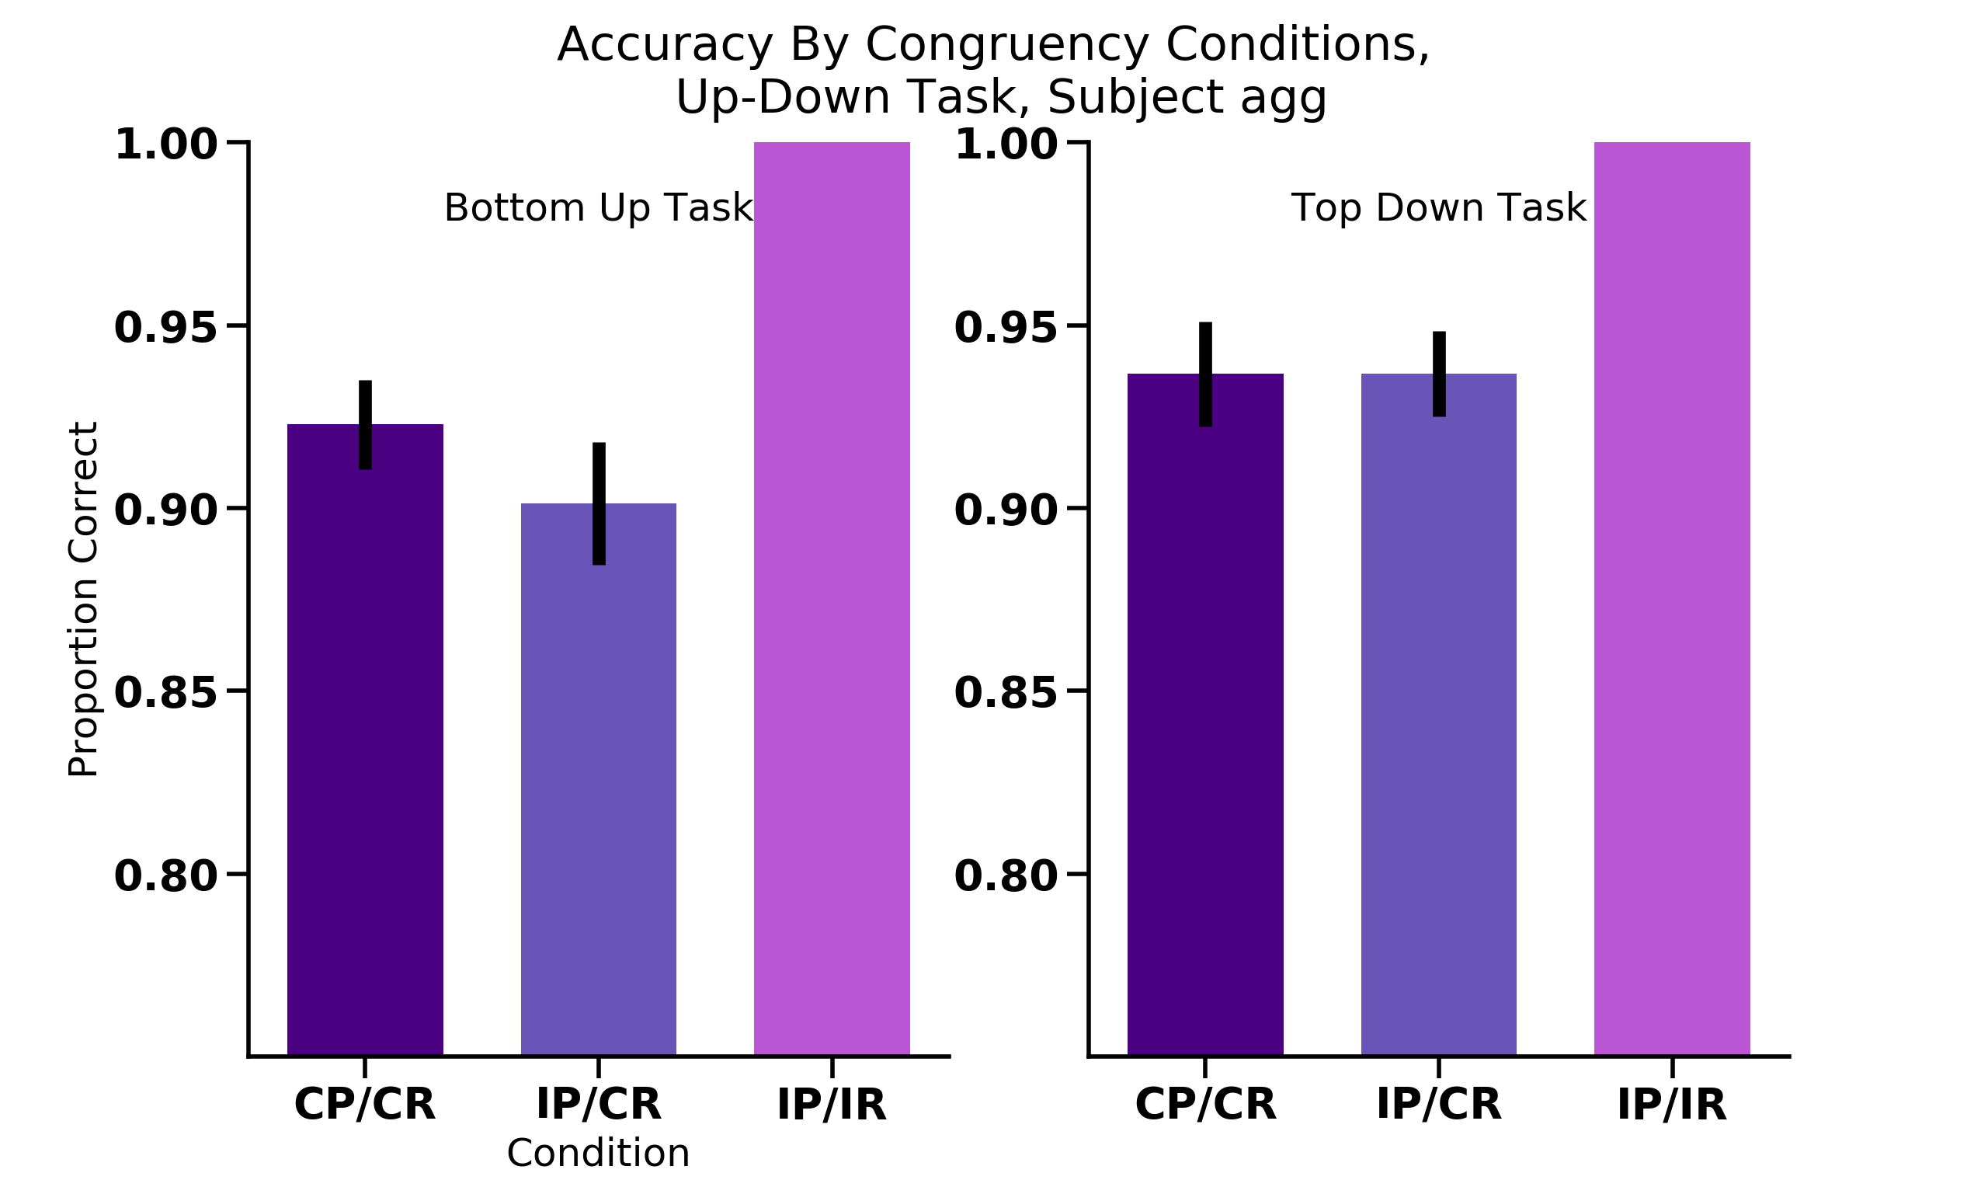
UP
UP
UP
UP
UP
DOWN
UP
UP
UP
UP
UP
DOWN
UP
UP
UP
UP
UP
DOWN
UP
UP
UP
UP
UP
DOWN

Slide 14
Percept
Response
UP
UP
UP
UP
UP
DOWN
UP
UP
UP
UP
UP
DOWN
N = 18

Slide 15
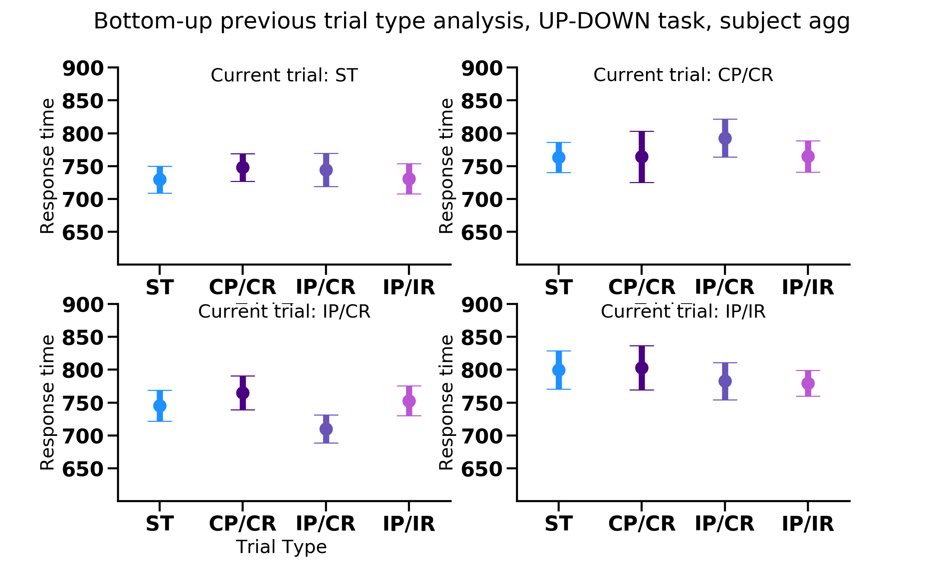
Previous trial type
Notes:
Stats
Plots:
Plot cong cong and incong/cong together on the same figure
Also plot with the xaxsi the same and put all three 2 trial types on same plot to see if there are main effects there (for each type of 2 target trial)
Better way to convey the material here??? Not x axis stuff here
Analysis:
1. check accoridng to whetehr response itself was repeated ornot repeated for each type of two target trial (collapsing across all 2 target trial types, and with the 1 target trial type )
2. Gratton (Grafton?) effect analysis (switching between congruent previous vs. incongruent previous trial) sequence effects
3. Separate out the response trials wrt to whether the same response or diff response (e.g., cong/cong trials, whether same response as this trial or different response)
Bernhard Hommel (shared representations) BBS paper- theory of event coding

Slide 16
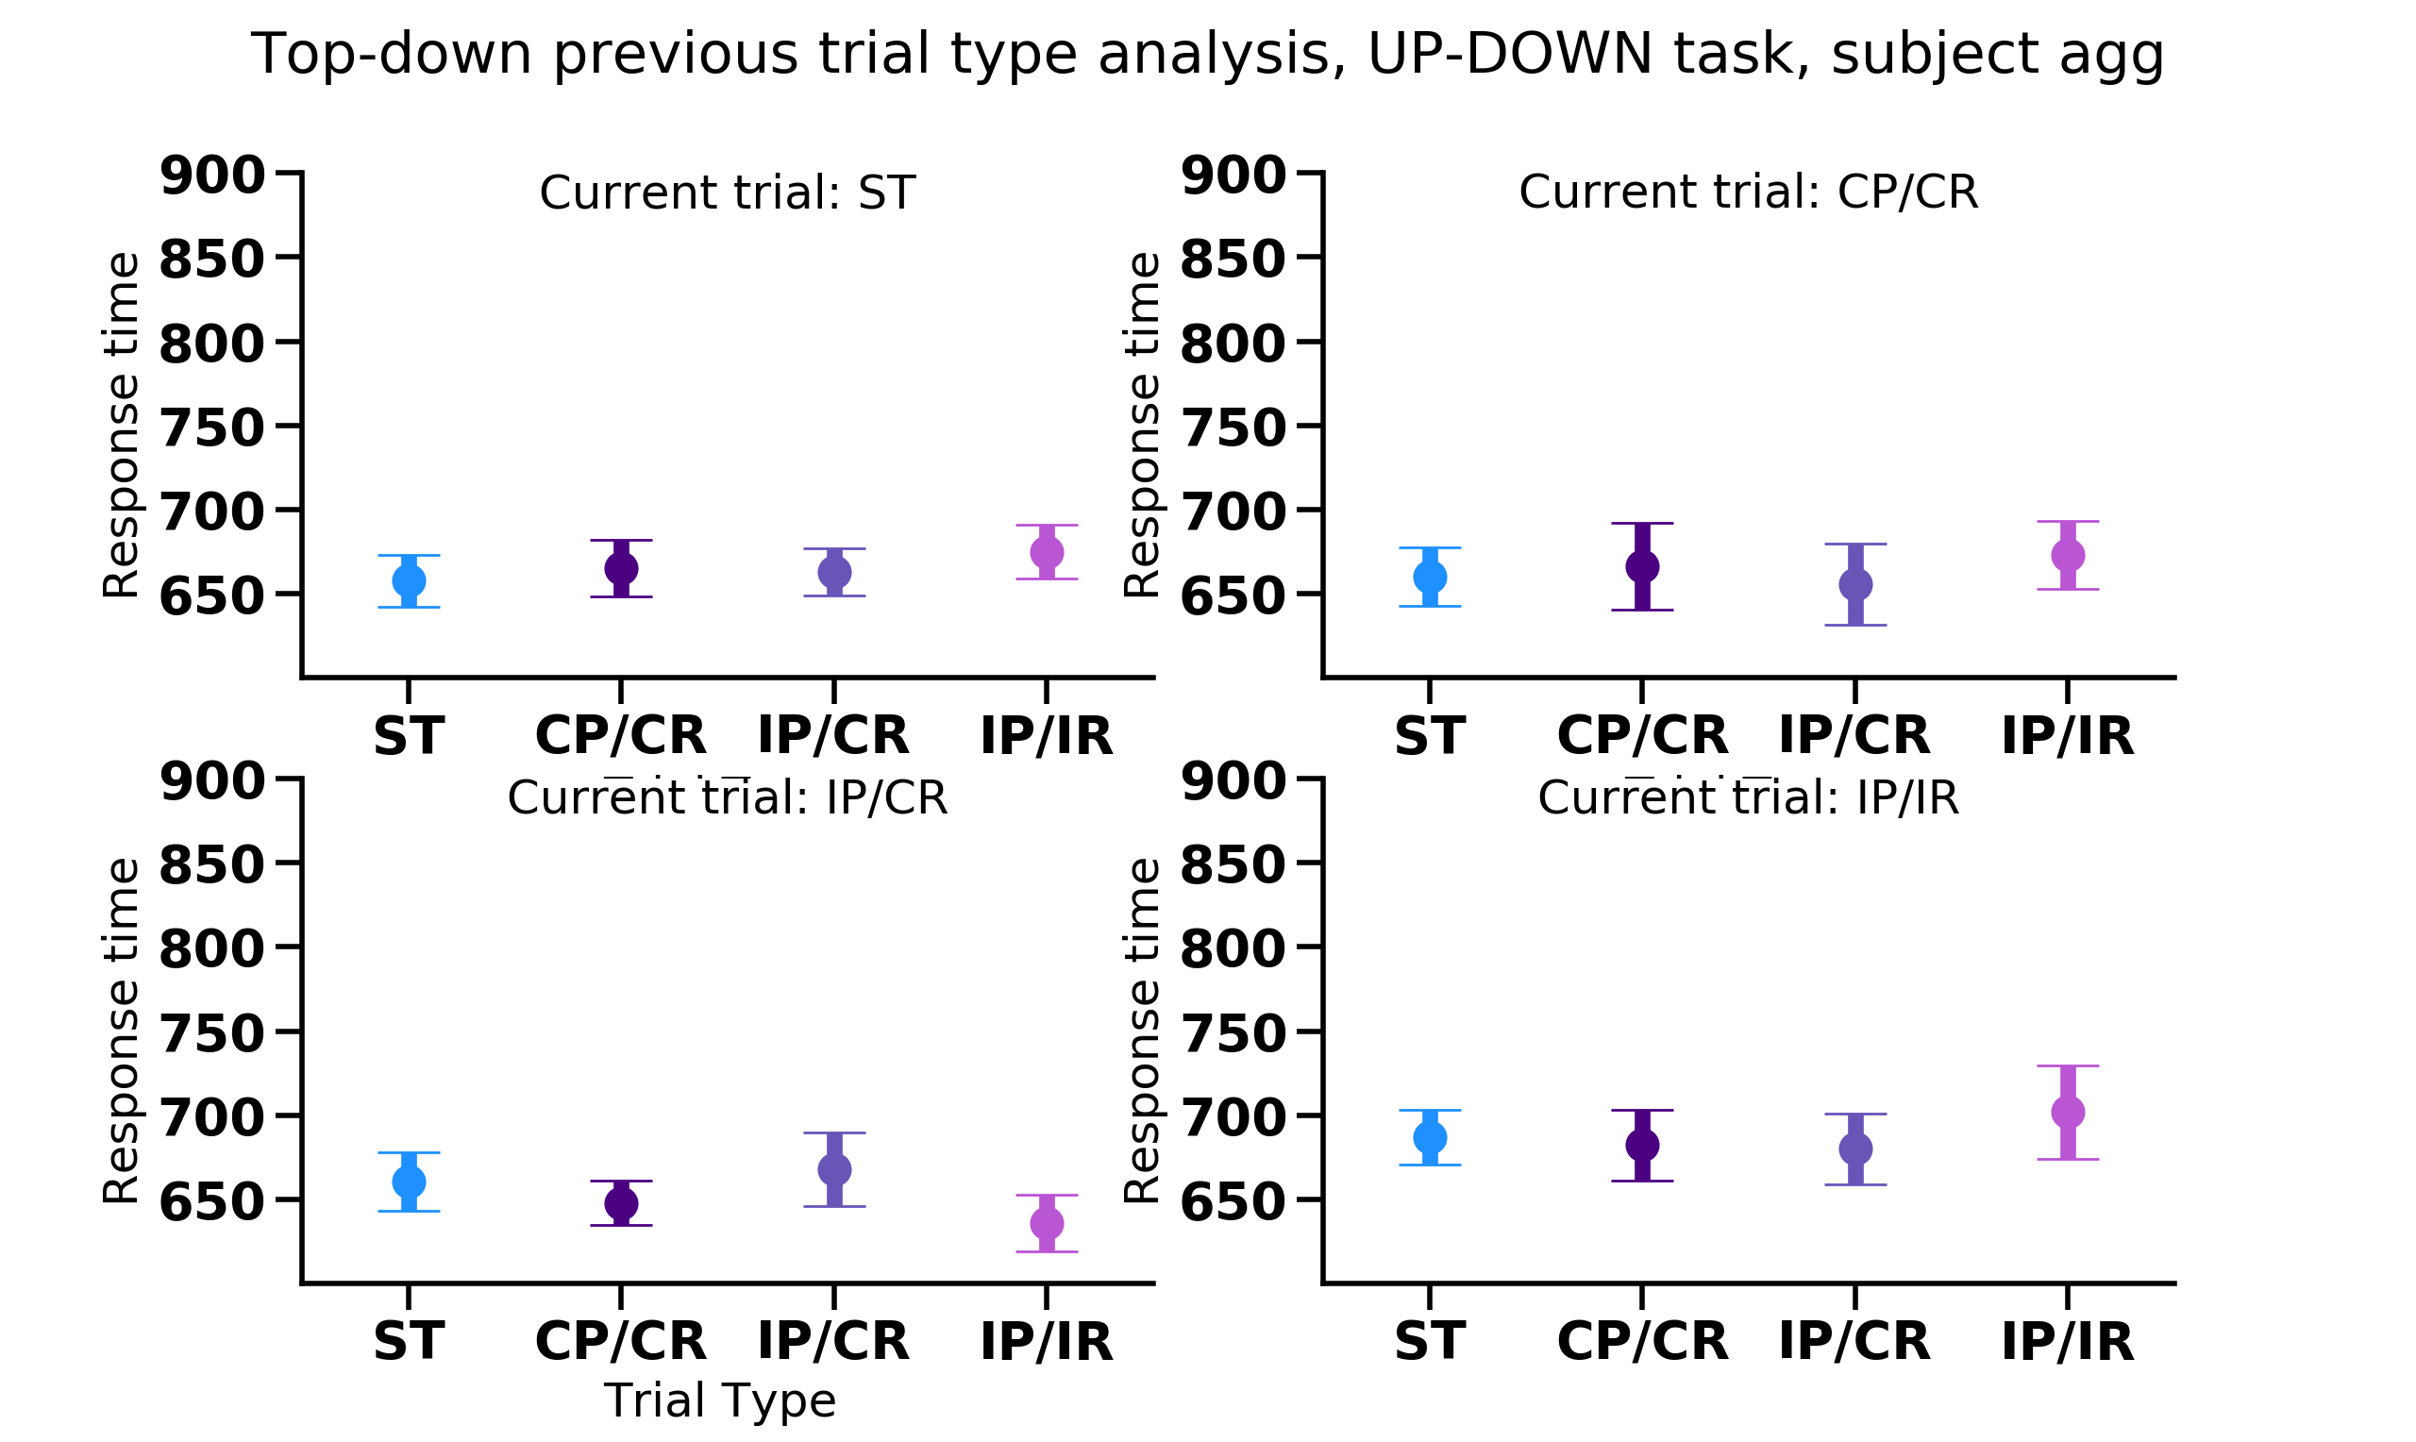
Previous trial type

Slide 17
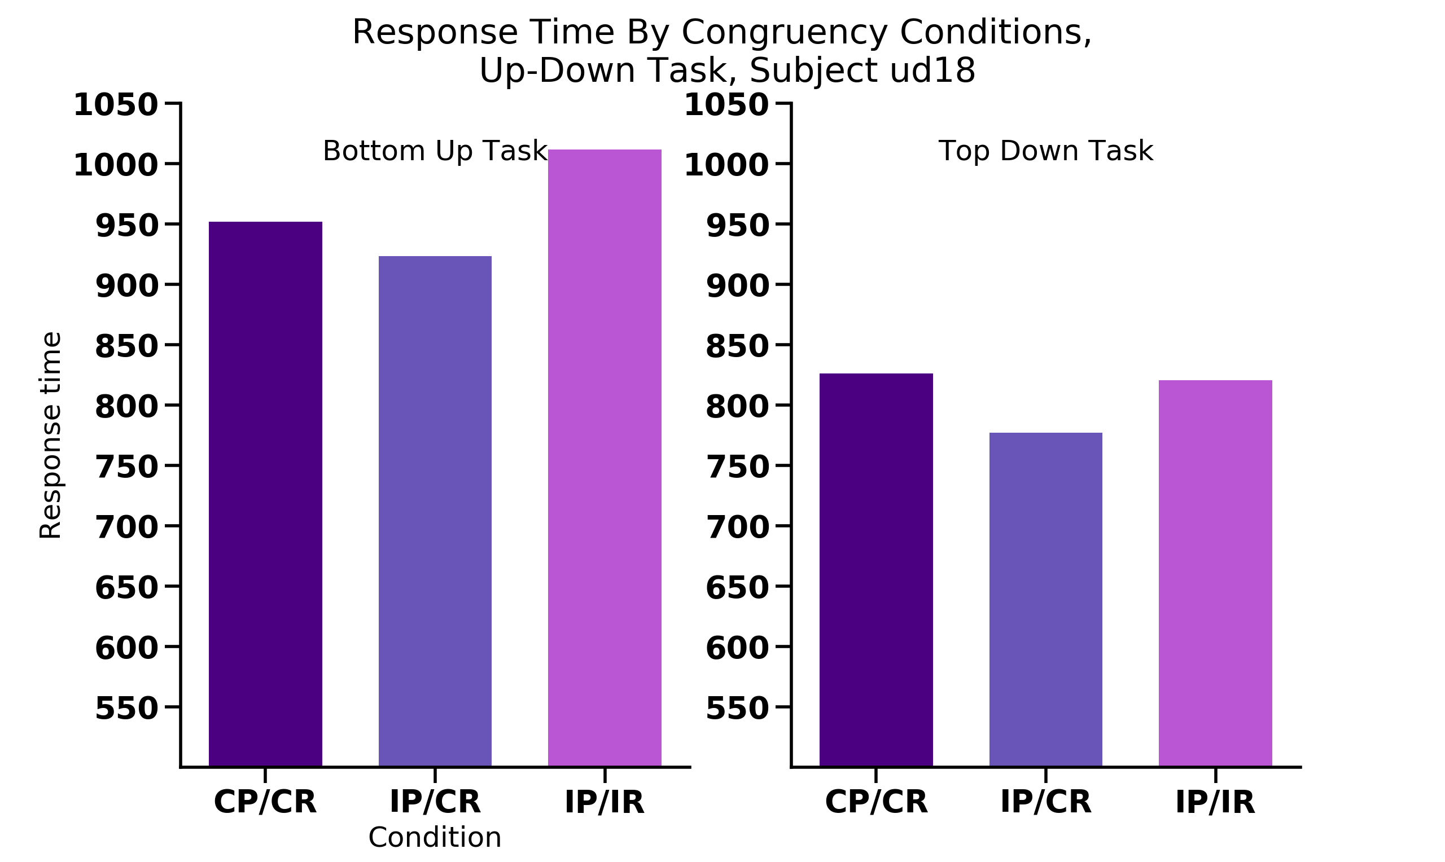
Percept
Response
UP
UP
UP
UP
UP
DOWN
UP
UP
UP
UP
UP
DOWN

Slide 18
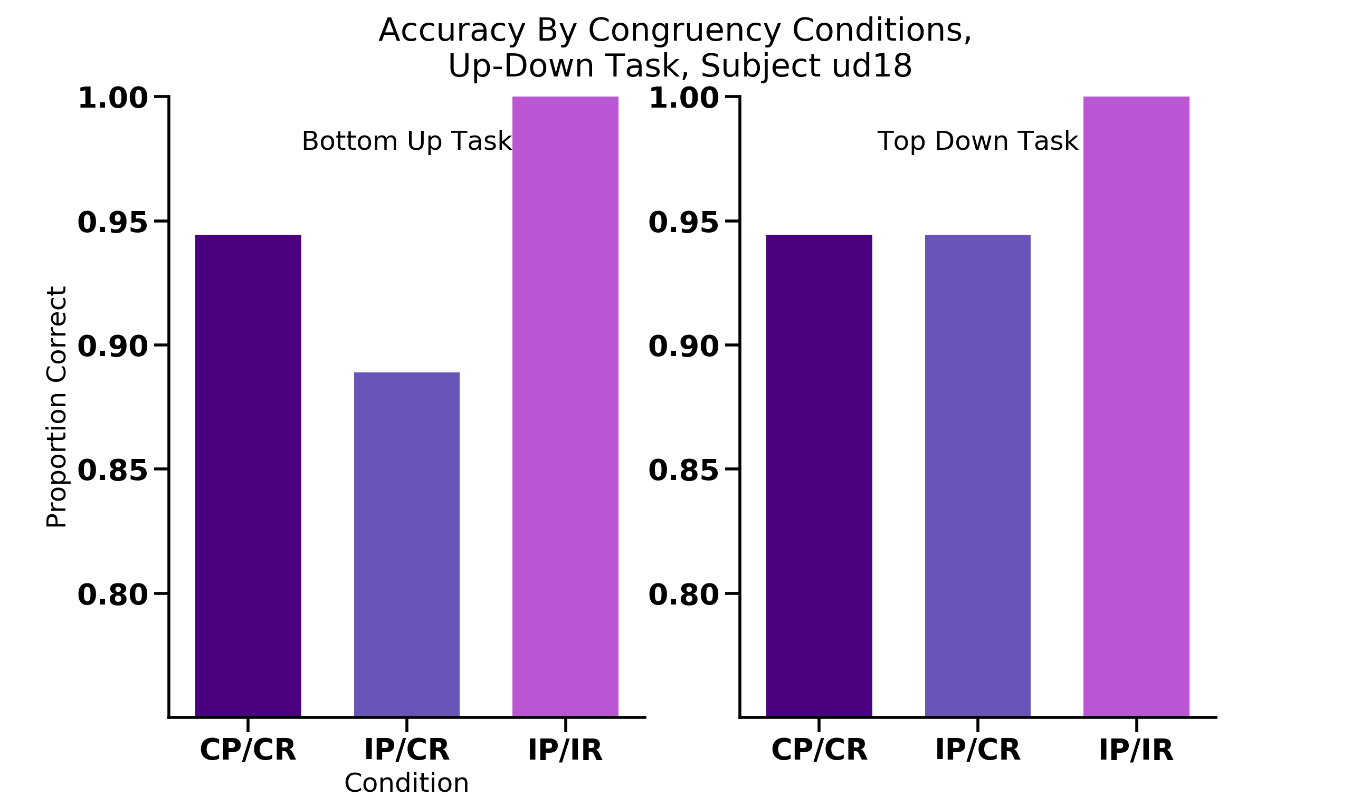
Percept
Response
UP
UP
UP
UP
UP
DOWN
UP
UP
UP
UP
UP
DOWN

Slide 19
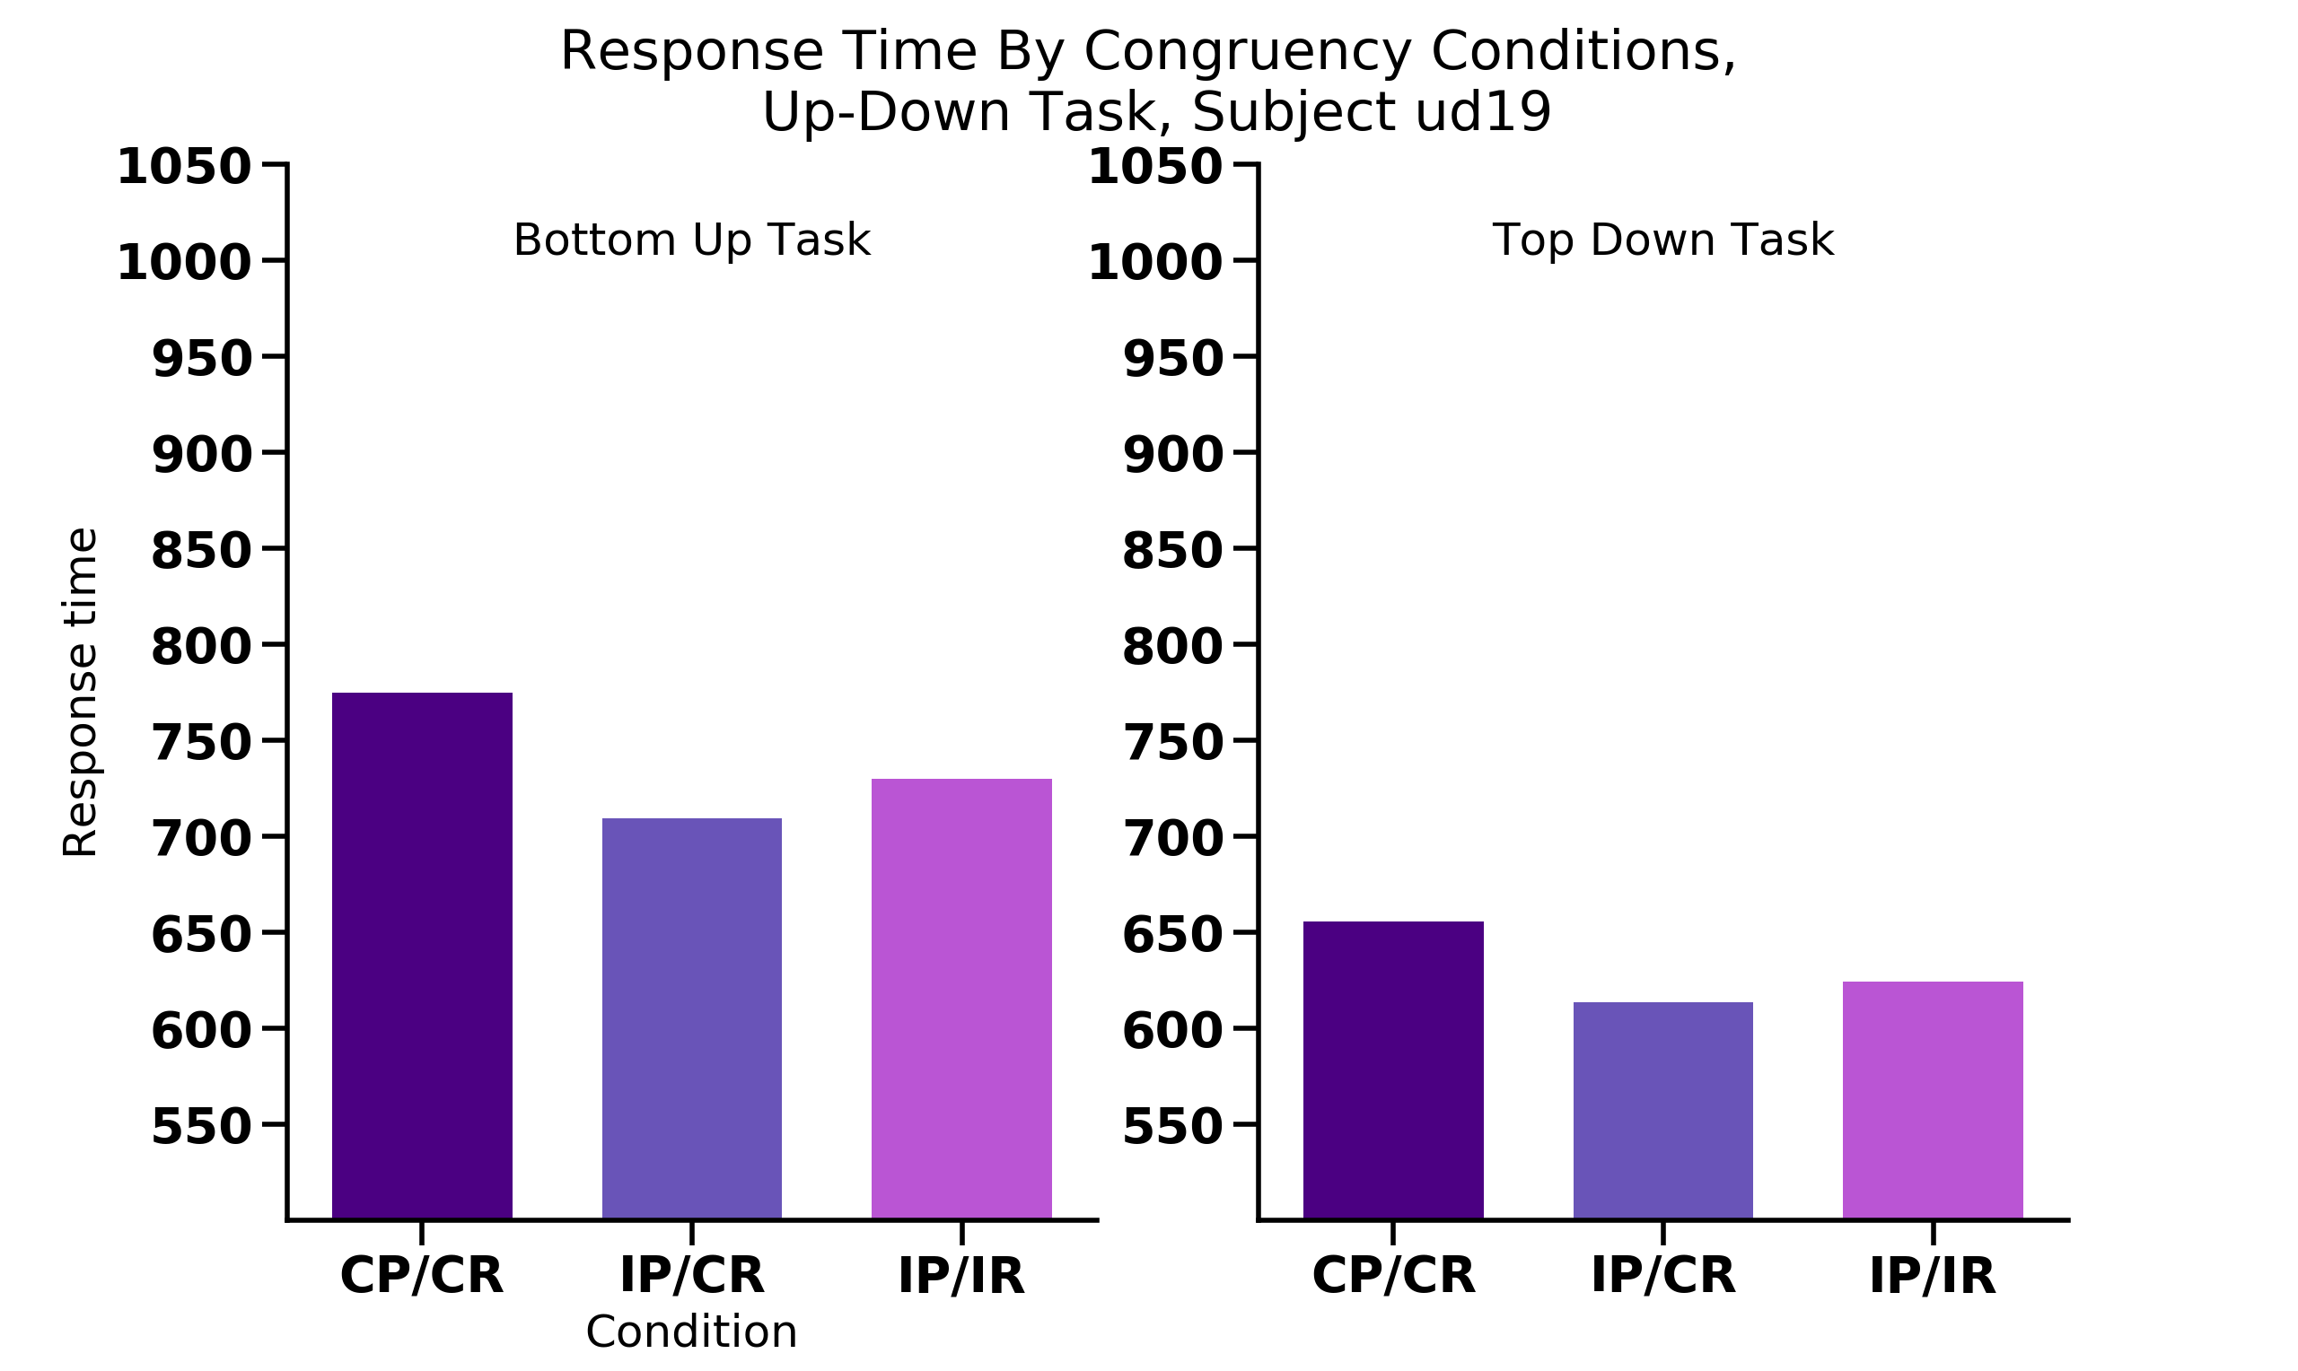
Percept
Response
UP
UP
UP
UP
UP
DOWN
UP
UP
UP
UP
UP
DOWN

Slide 20
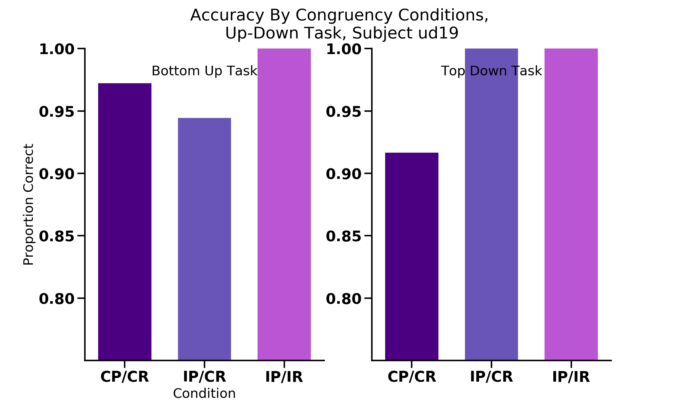
Percept
Response
UP
UP
UP
UP
UP
DOWN
UP
UP
UP
UP
UP
DOWN

Slide 21
16 participants
Congruent/Congruent = NOT FASTEST condition

Slide 22
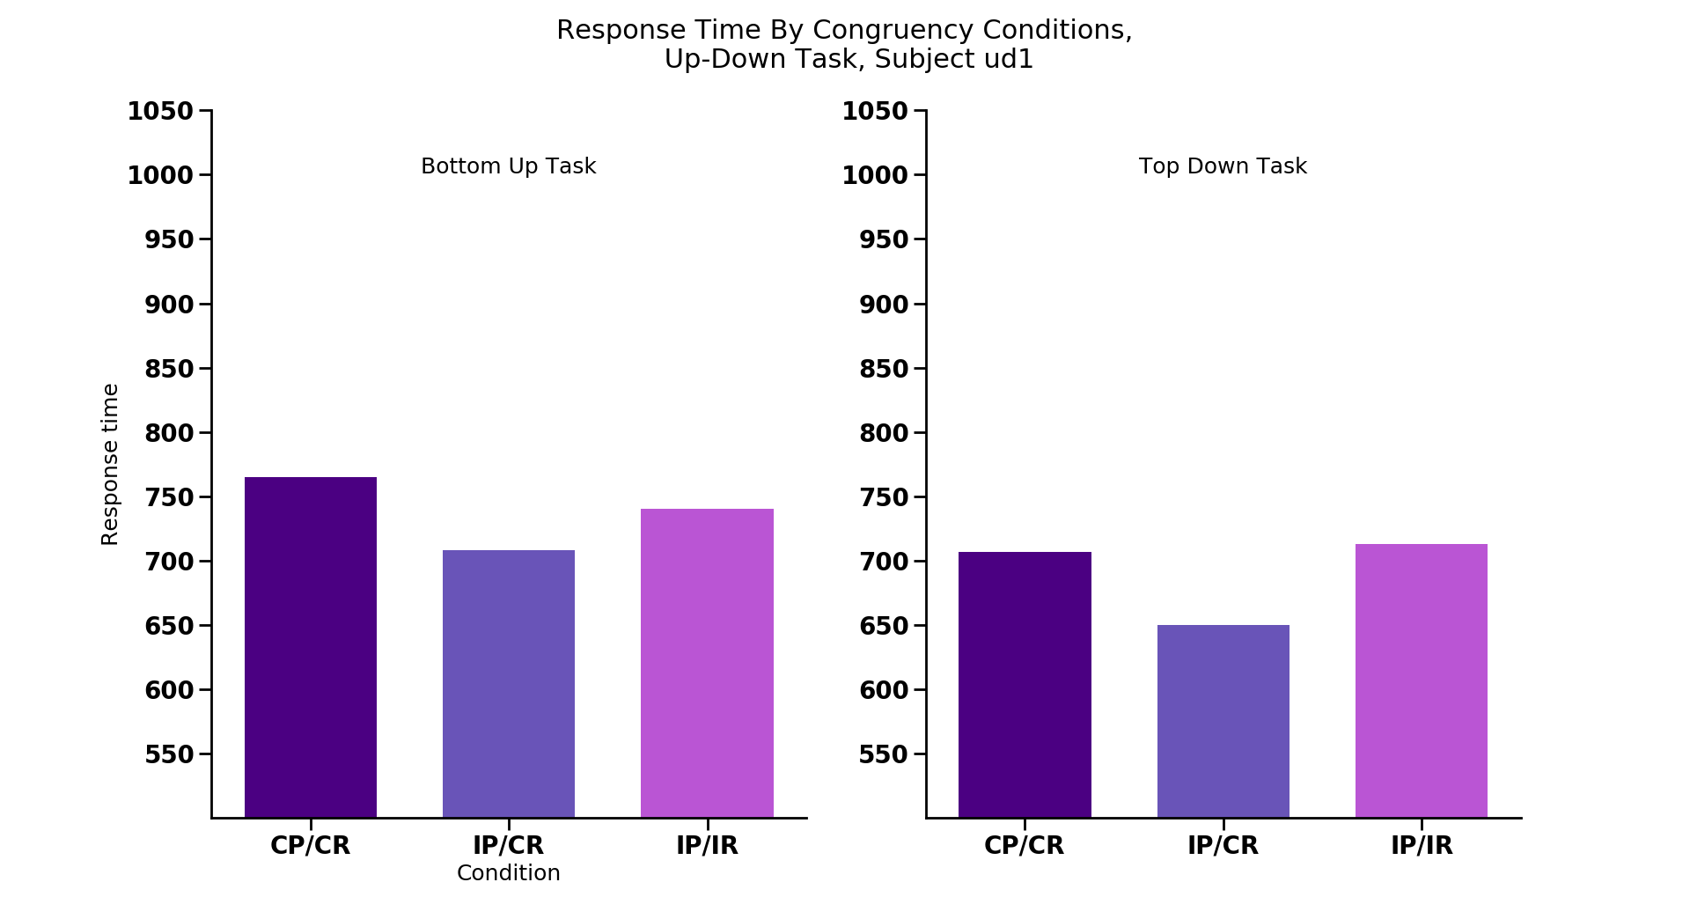
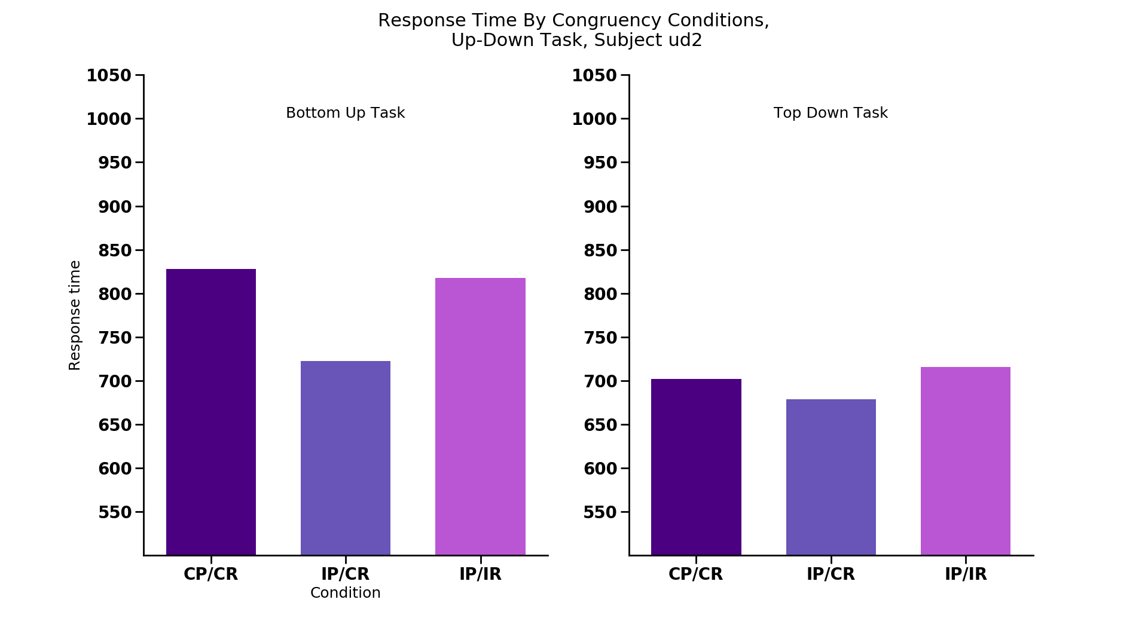
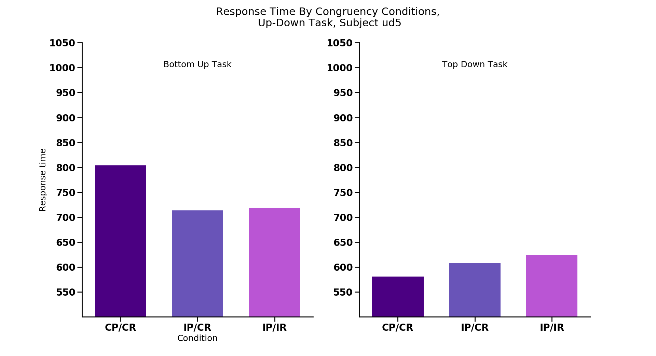
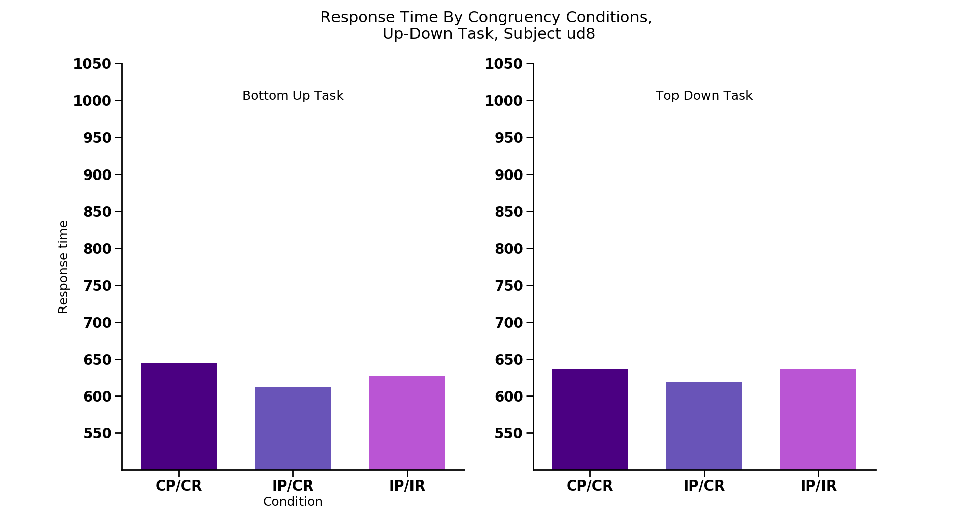
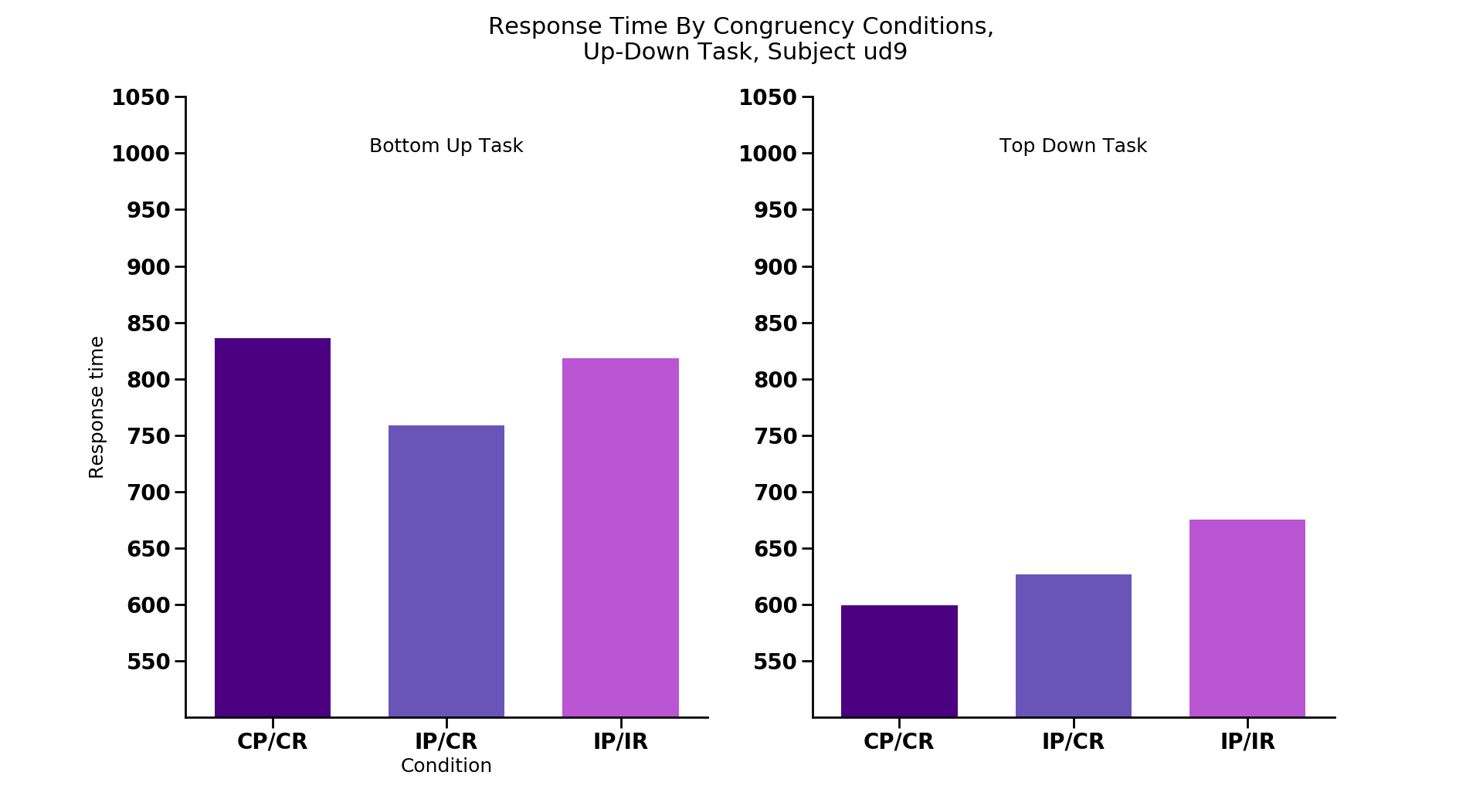
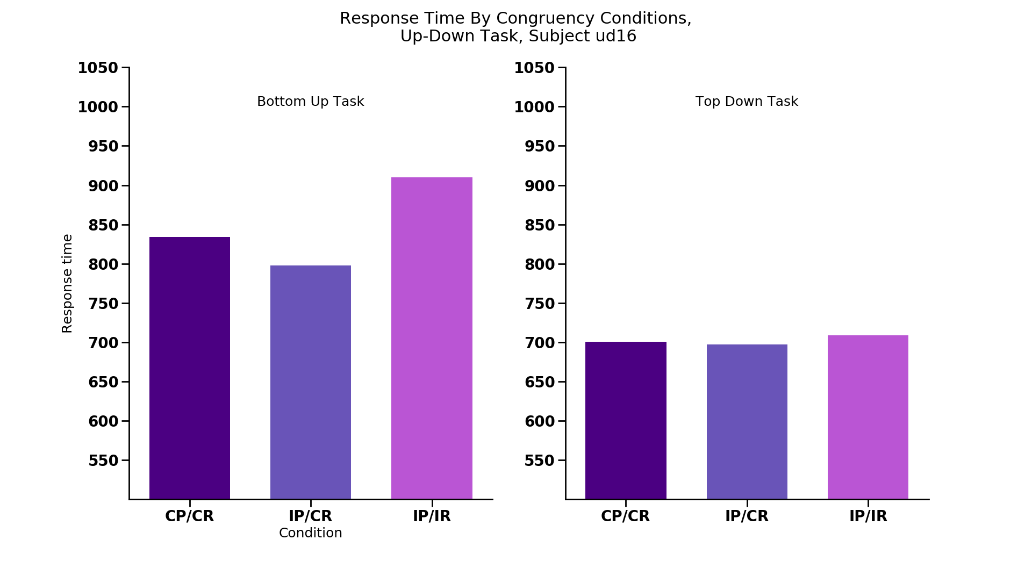
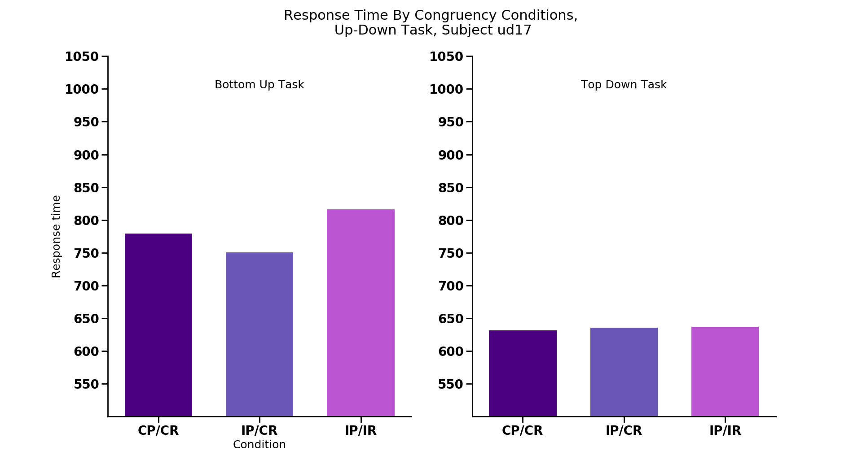
*
*
*
*
CC
IC
II
CC
IC
II
CC
IC
II
CC
IC
II
CC
IC
II
CC
IC
II
CC
IC
II
CC
IC
II
*
CC
IC
II
CC
IC
II
CC
IC
II
CC
IC
II
CC
IC
II
CC
IC
II
Notes:
NON-REPLICATING SUBJECTS: each congruency condition
Ud1 (also TD), ud2 (also for TD, small), ud5 (large), ud8, ud9 (large), ud16, ud17

Slide 23
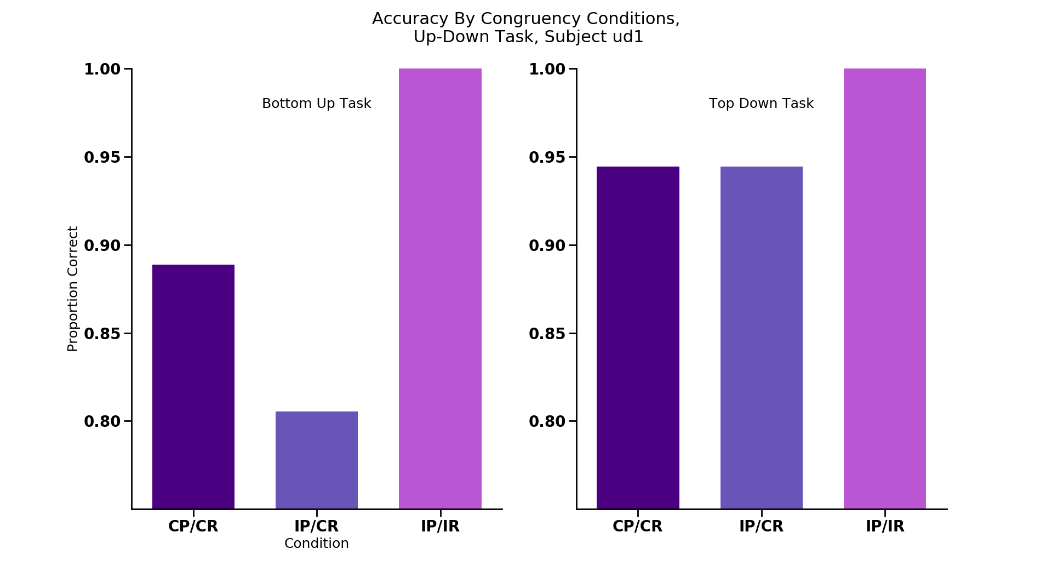
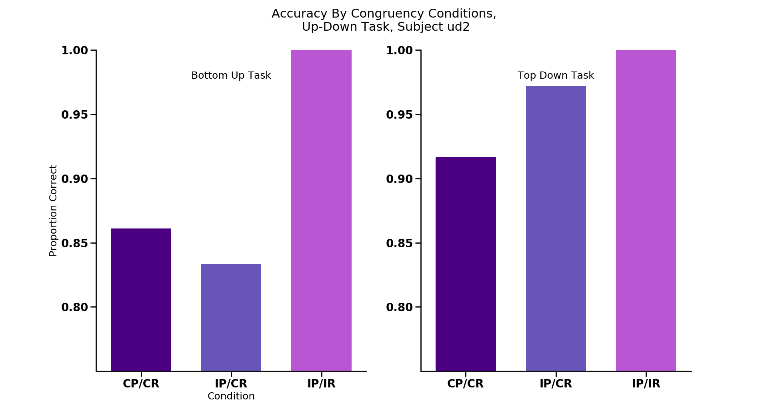
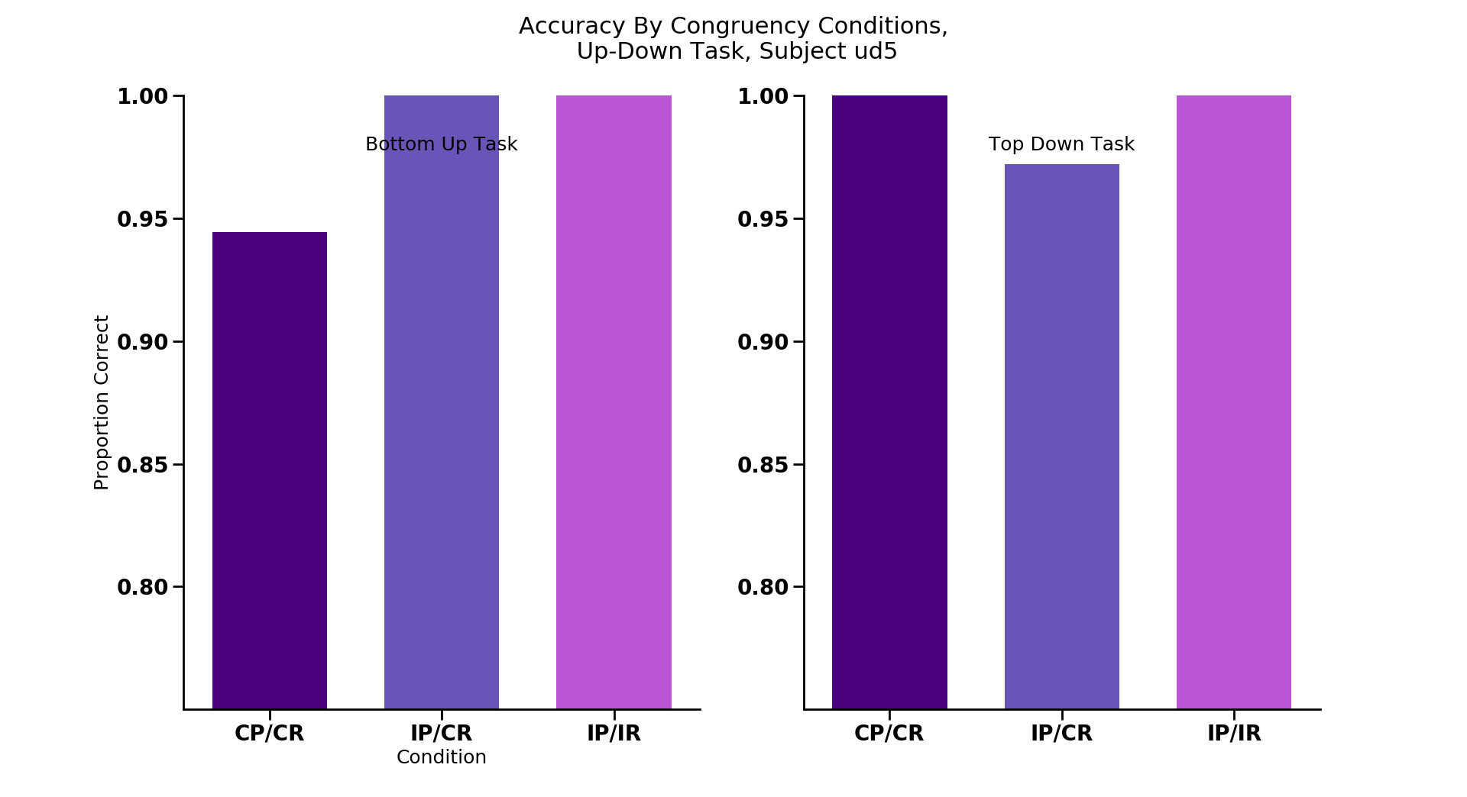
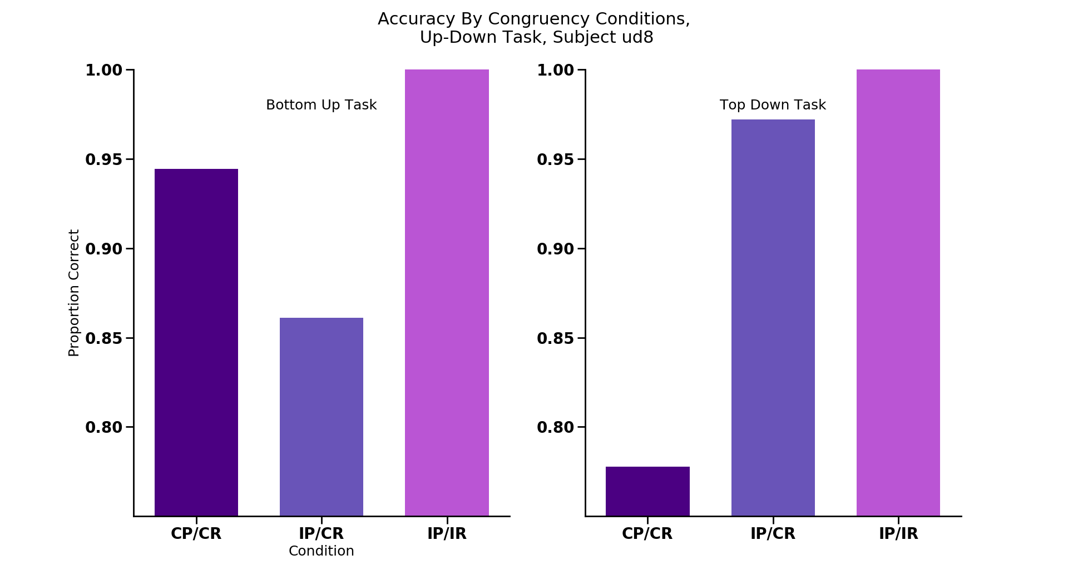
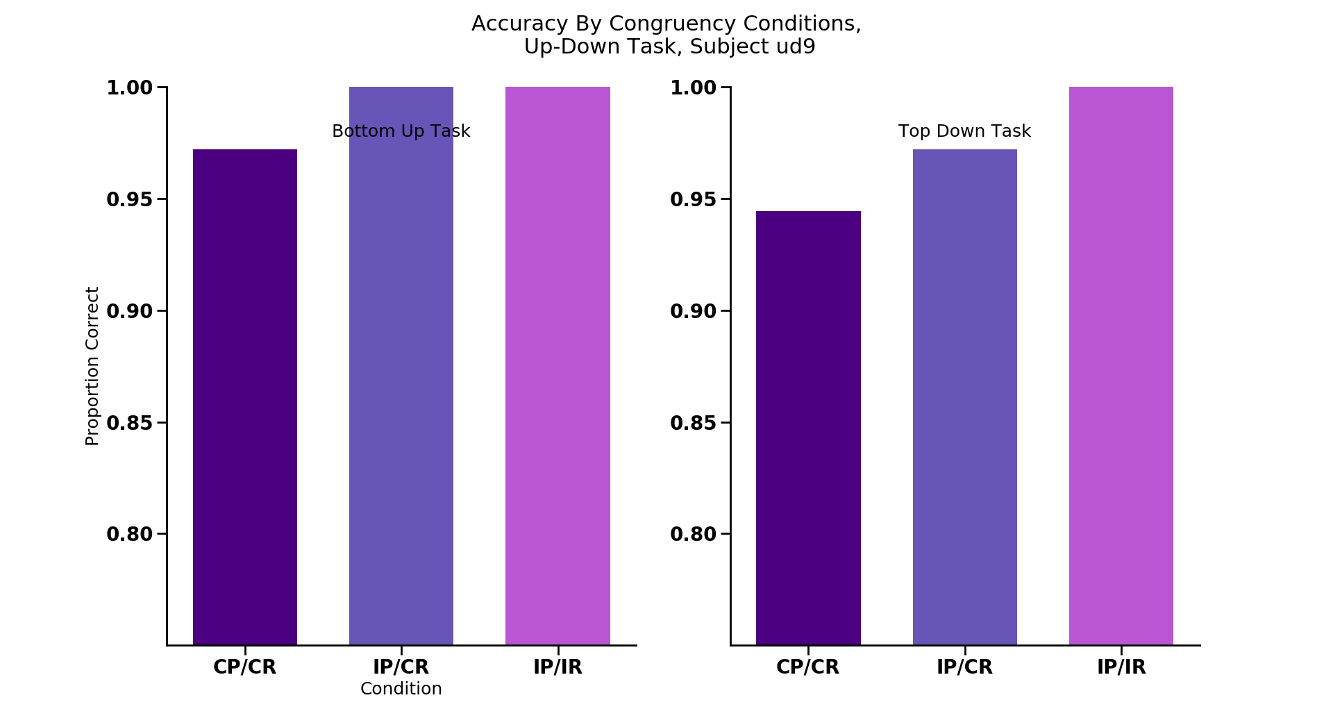
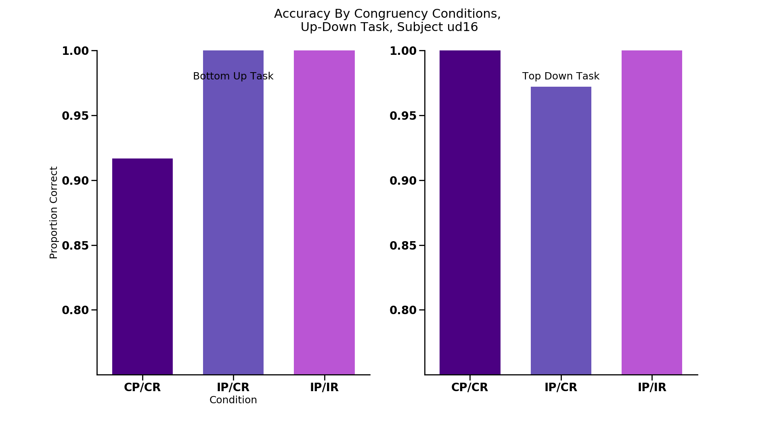
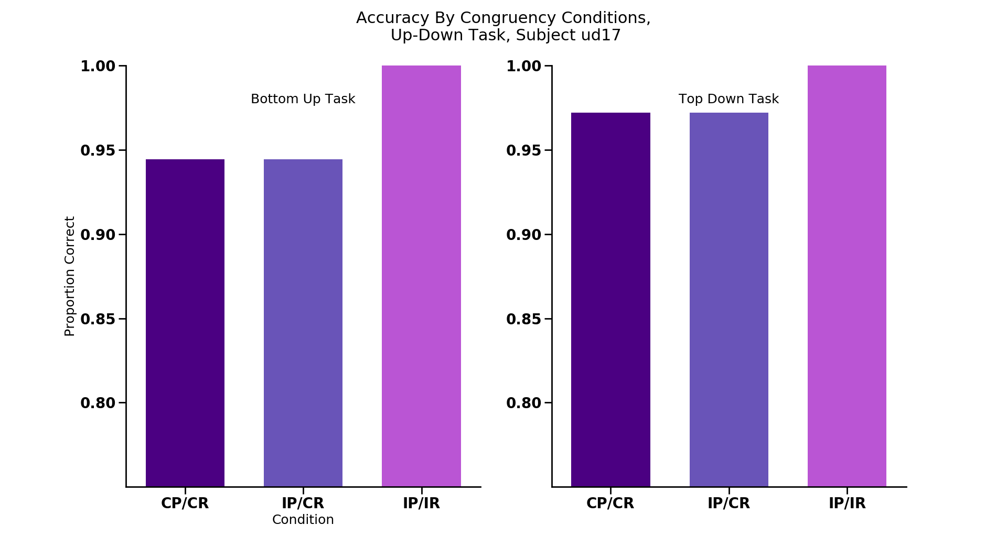
*
*
*
*
CC
IC
II
CC
IC
II
CC
IC
II
CC
IC
II
CC
IC
II
CC
IC
II
CC
IC
II
CC
IC
II
*
CC
IC
II
CC
IC
II
CC
IC
II
CC
IC
II
CC
IC
II
CC
IC
II
Notes:
NON-REPLICATING SUBJECTS: each congruency condition ACCURACY

Slide 24
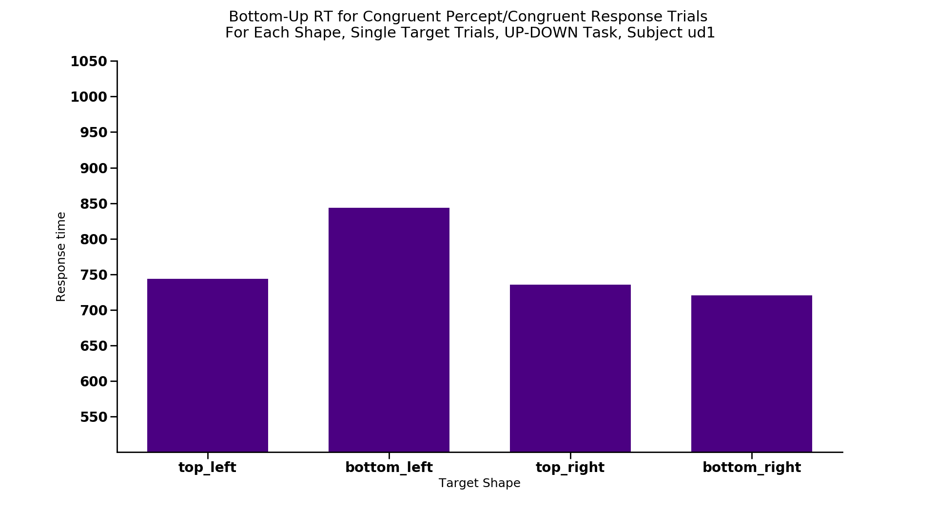
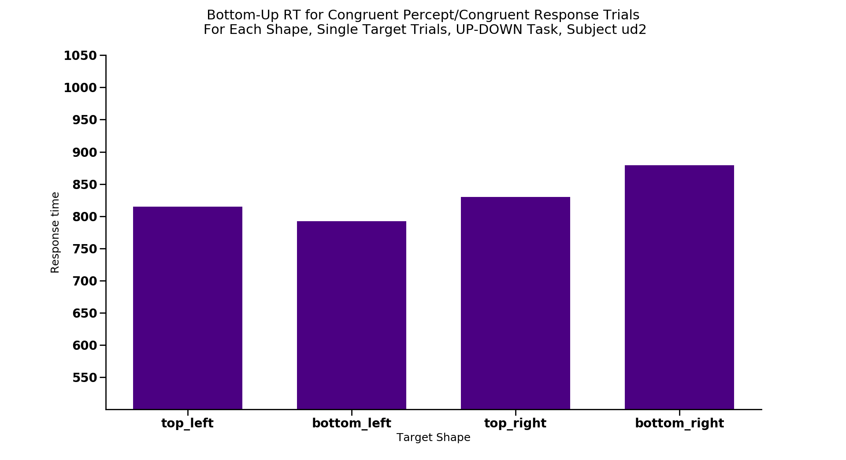
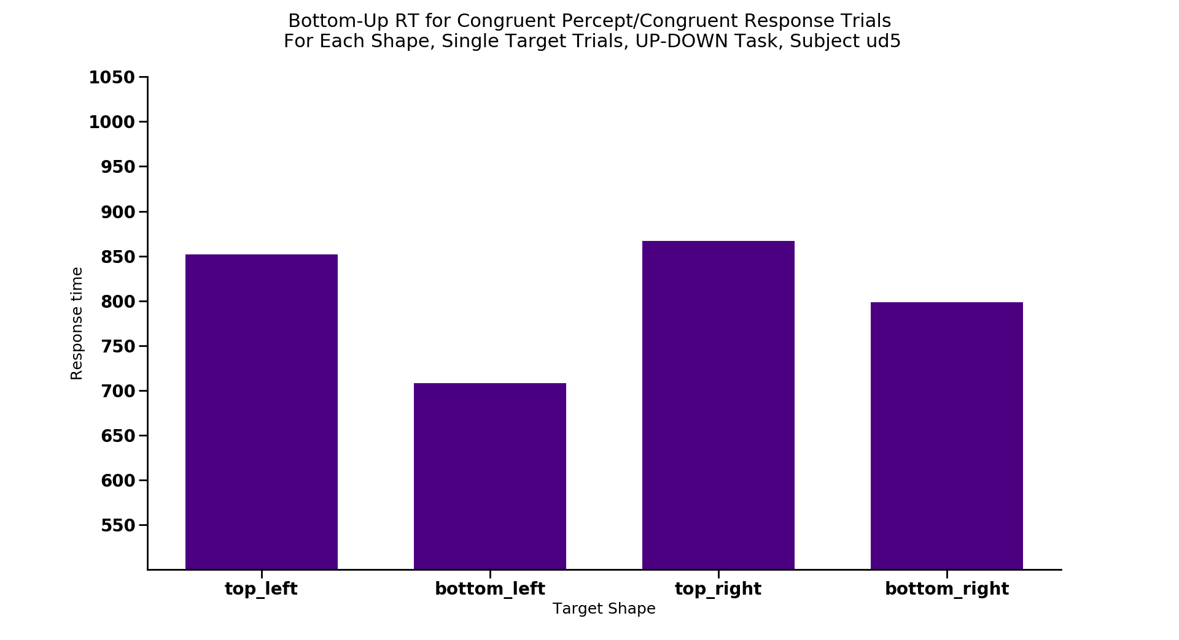
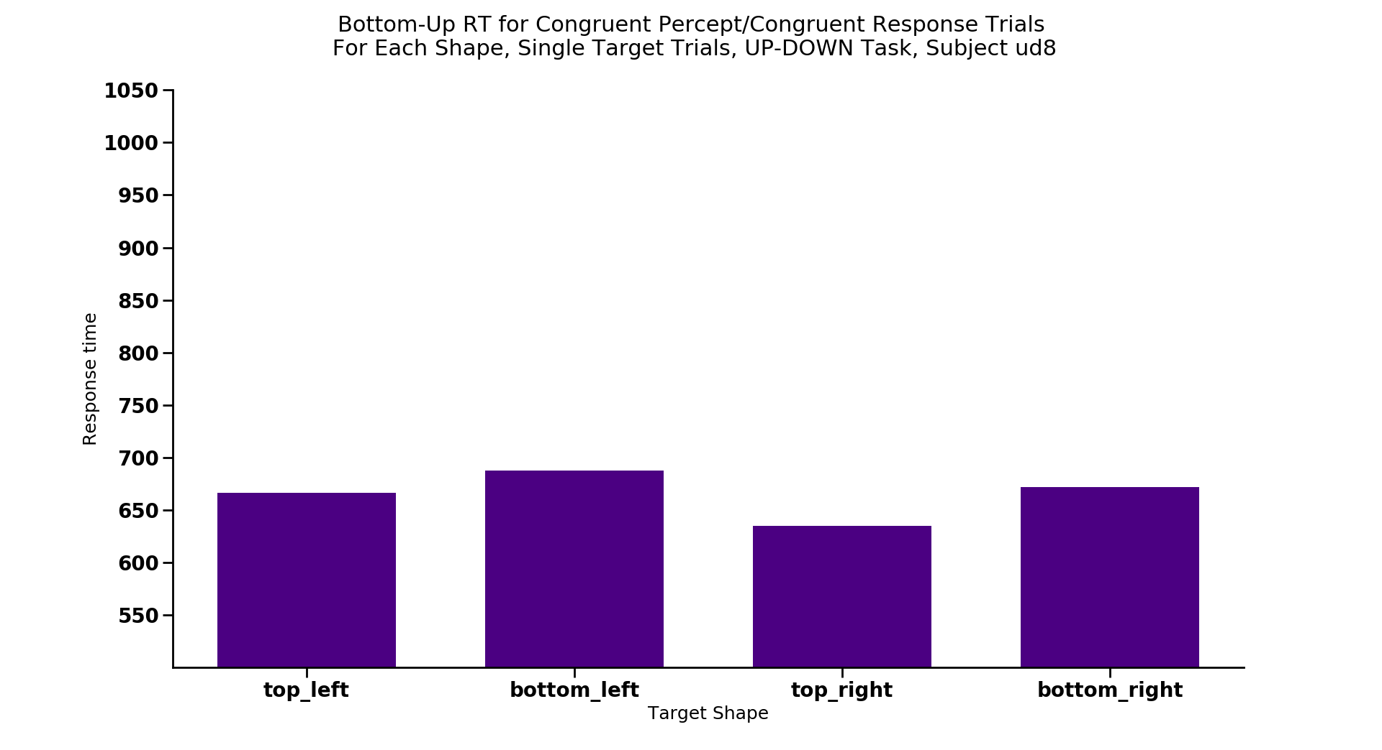
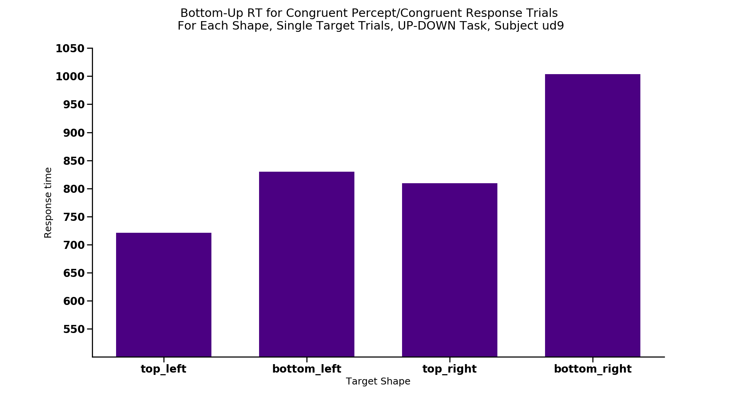
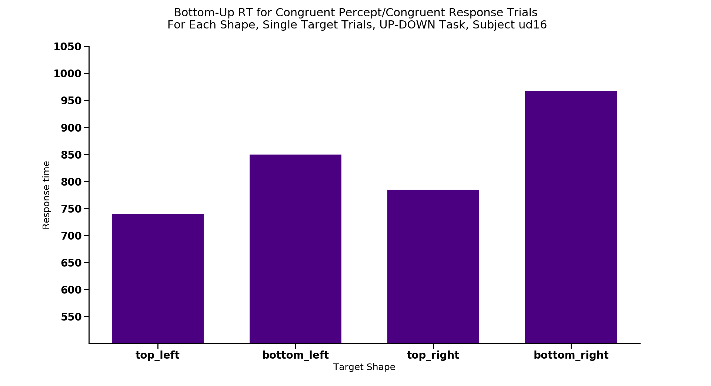
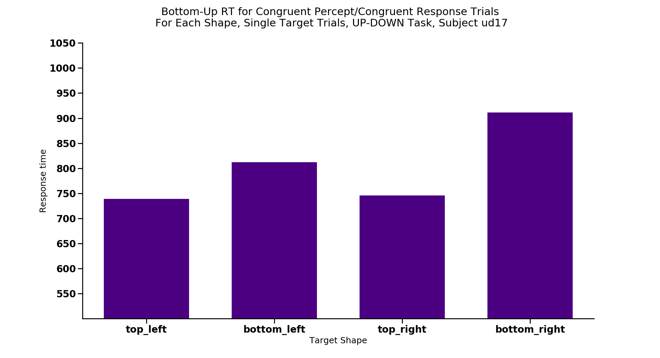
*
*
*
*
*
Notes:
Max 12 trials each

Slide 25
Congruent/Congruent = FASTEST condition

Slide 26
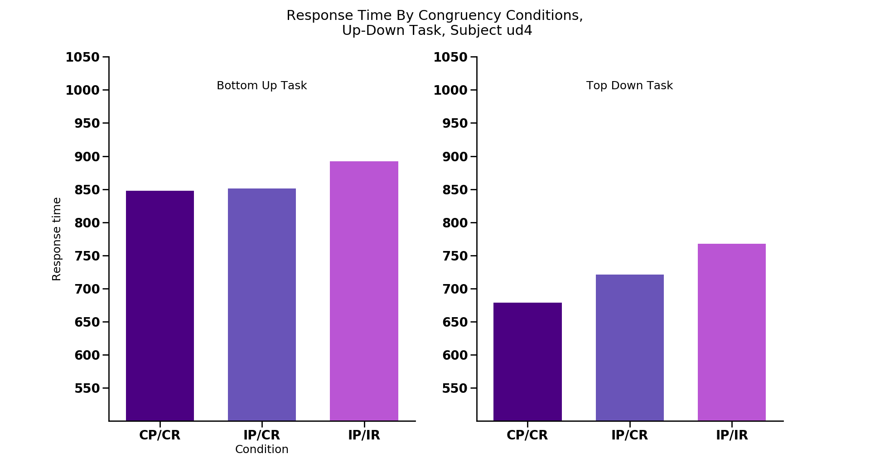
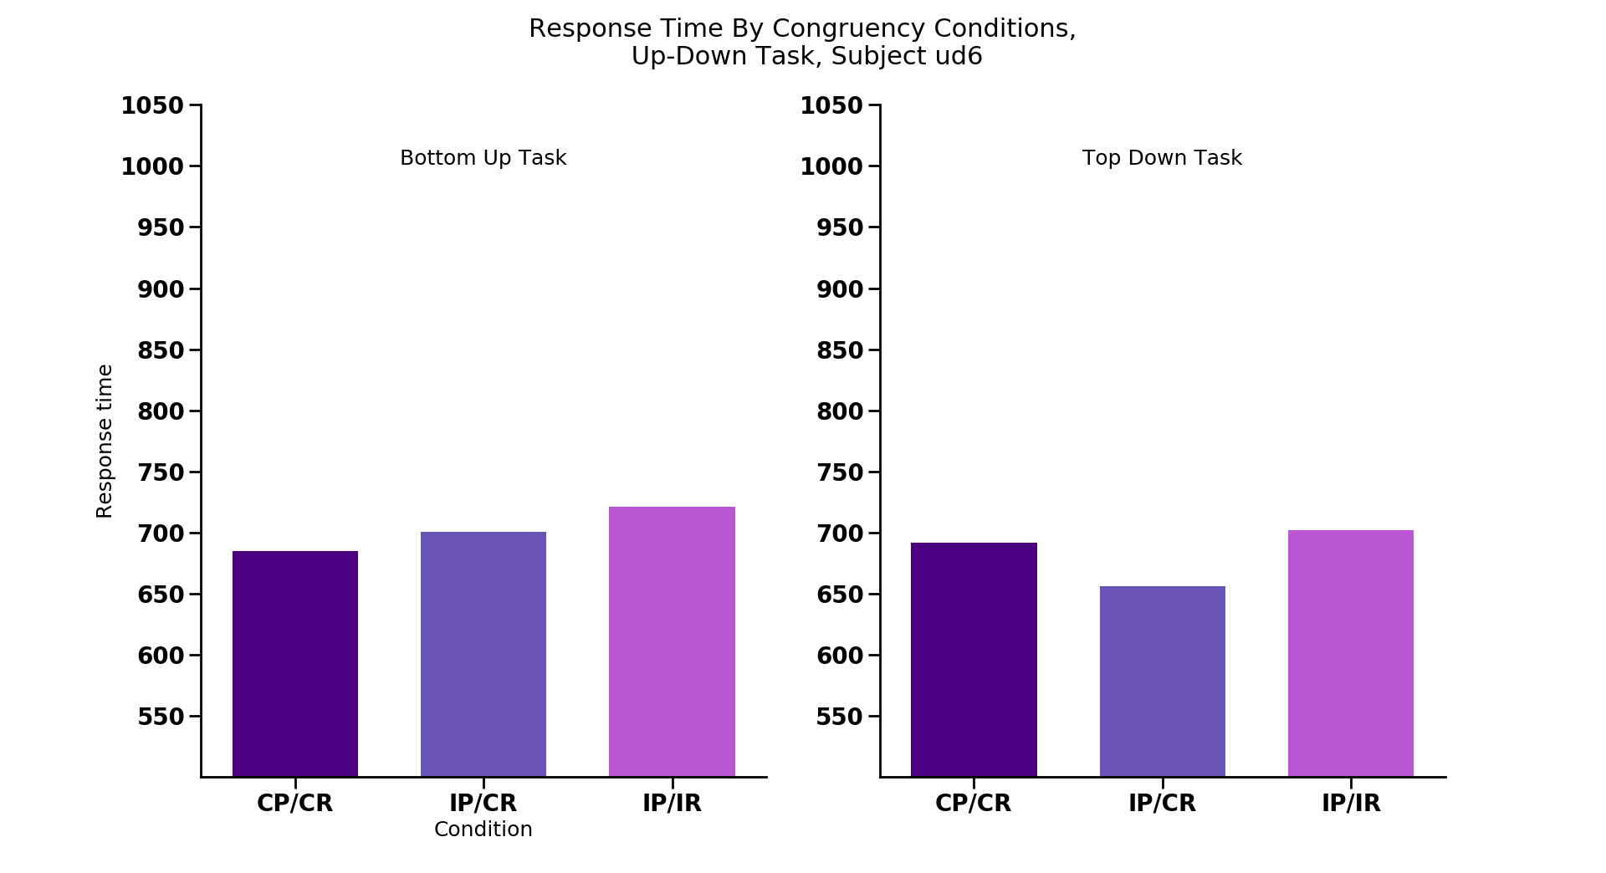
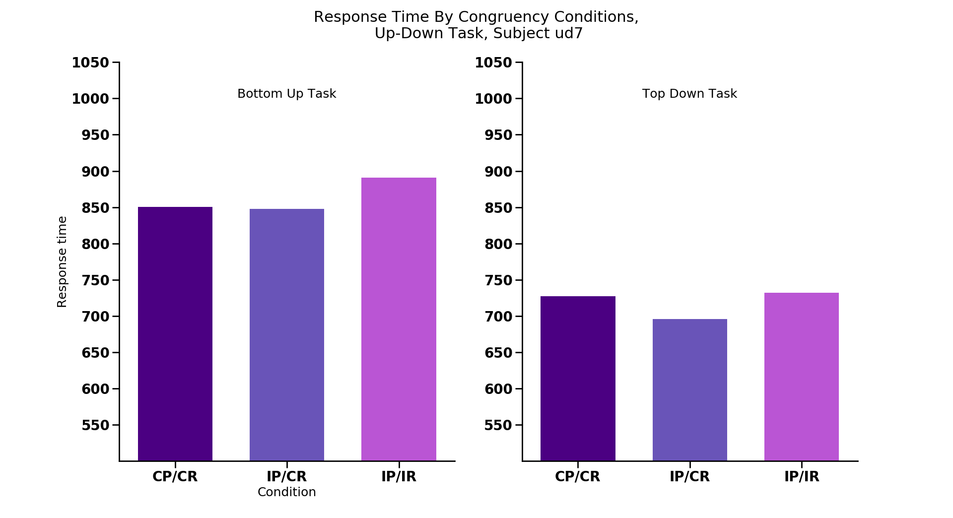
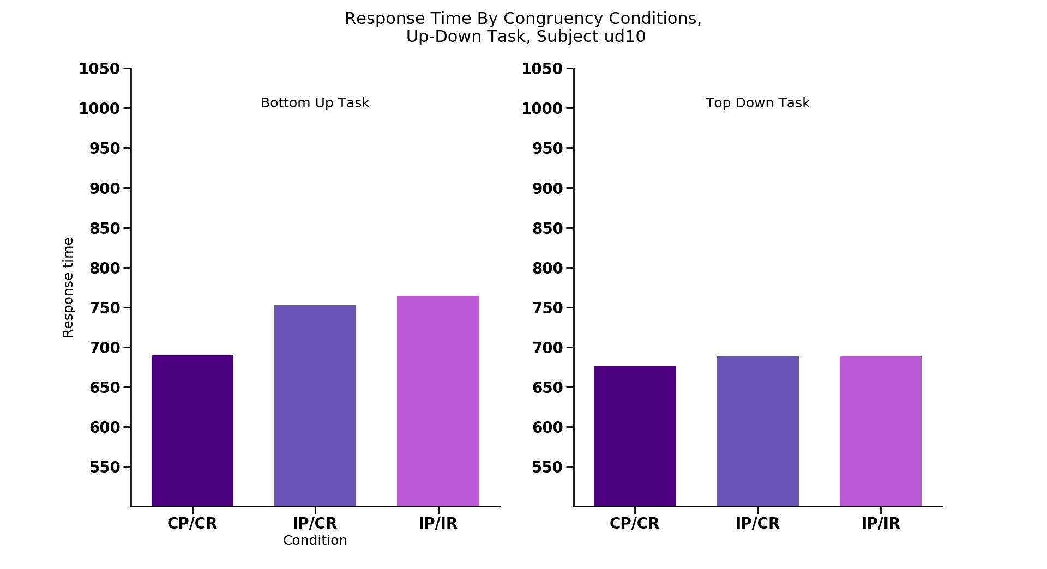
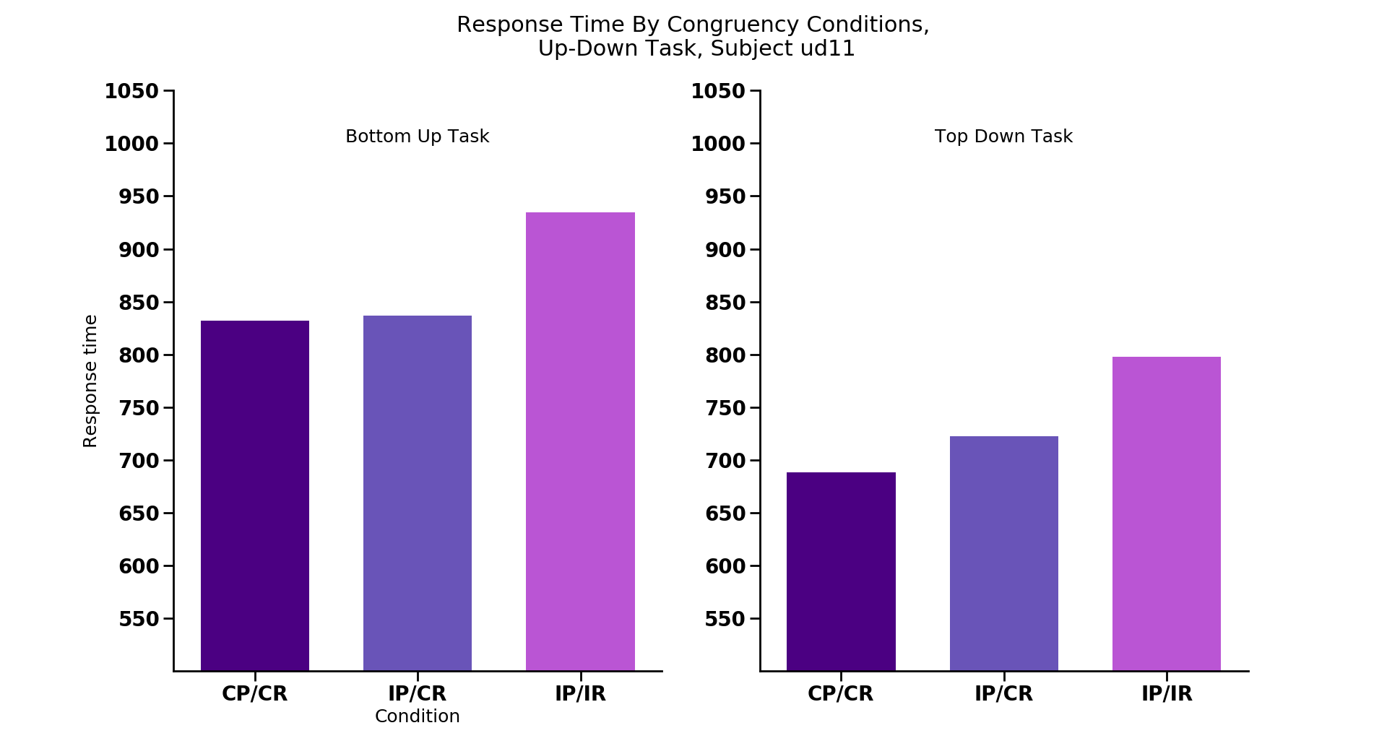
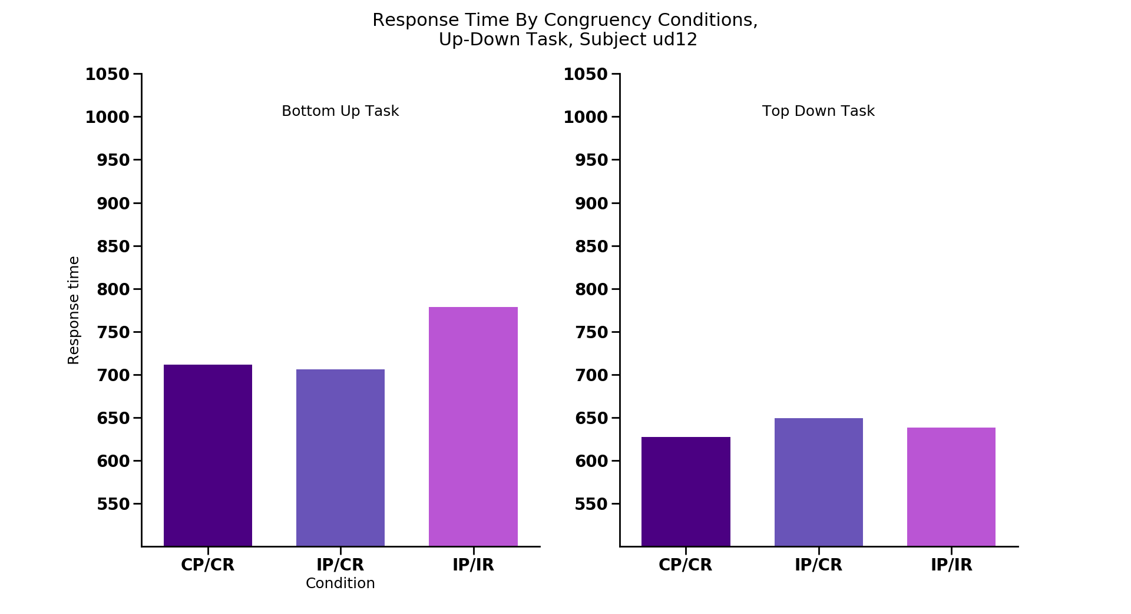
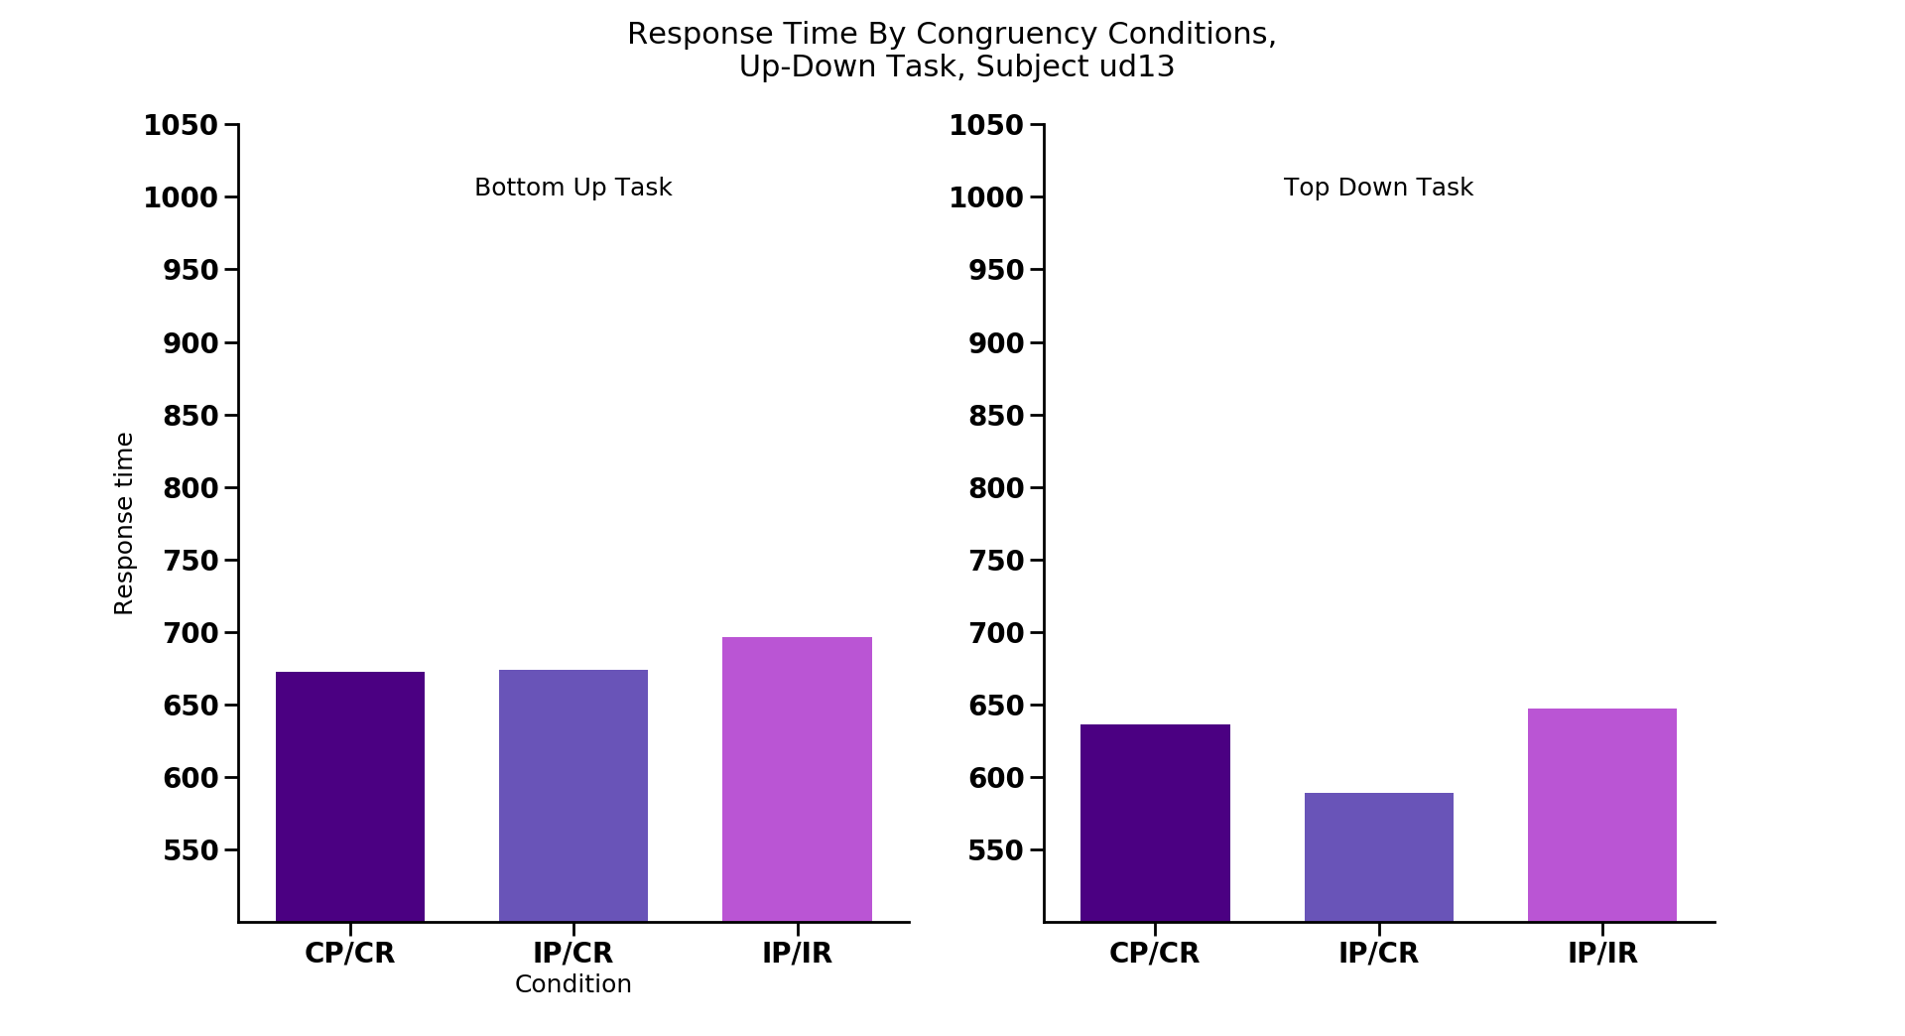
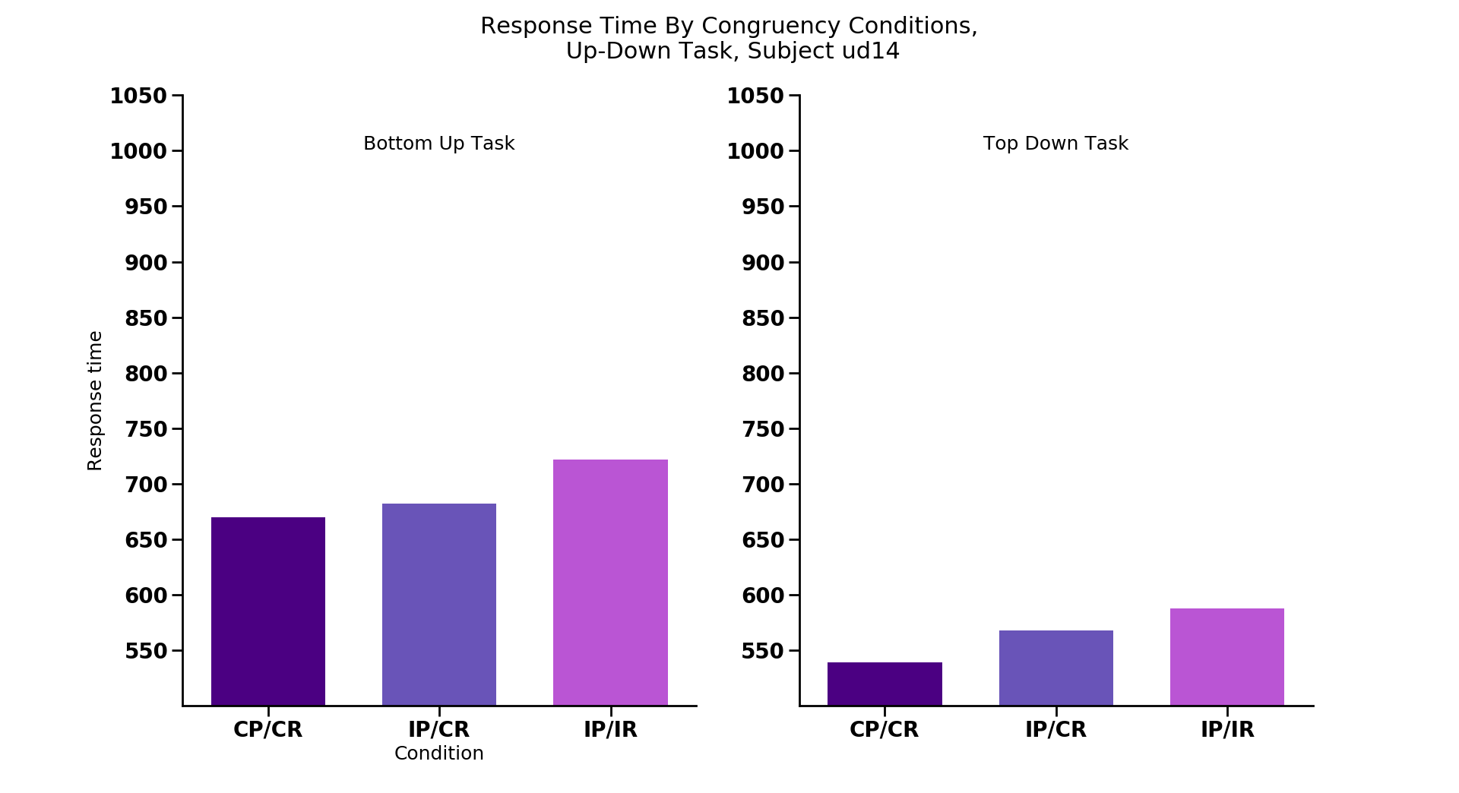
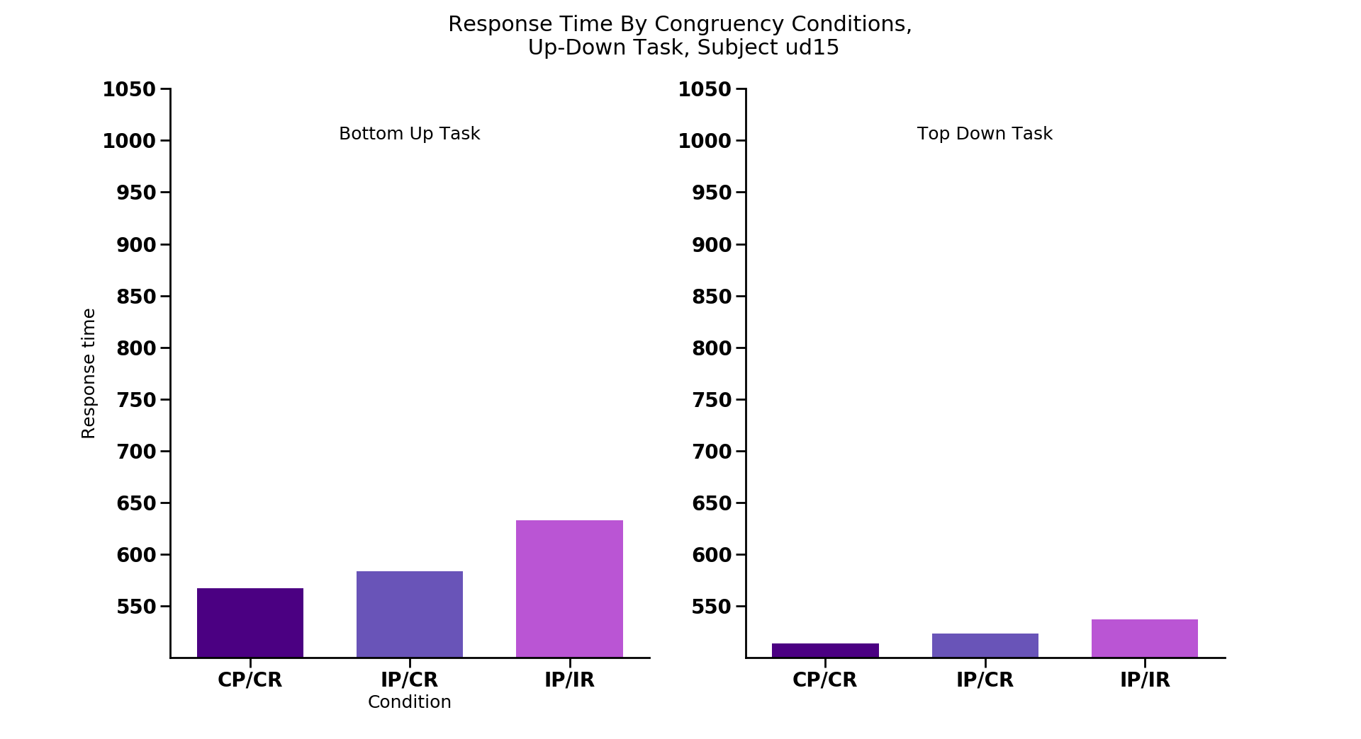
CC
IC
II
CC
IC
II
CC
IC
II
CC
IC
II
CC
IC
II
CC
IC
II
CC
IC
II
CC
IC
II
CC
IC
II
CC
IC
II
CC
IC
II
CC
IC
II
CC
IC
II
CC
IC
II
CC
IC
II
CC
IC
II
CC
IC
II
CC
IC
II
Notes:
Replications congruency stuff
Ud4, ud6, ud7, ud10, ud11, ud12, ud13, ud14, ud15

Slide 27









CC
IC
II
CC
IC
II
CC
IC
II
CC
IC
II
CC
IC
II
CC
IC
II
CC
IC
II
CC
IC
II
CC
IC
II
CC
IC
II
CC
IC
II
CC
IC
II
CC
IC
II
CC
IC
II
CC
IC
II
CC
IC
II
CC
IC
II
CC
IC
II
Notes:
Replications congruency accuracy

Slide 28









Notes:
ST BIAS

Slide 29

One target
Cong/Cong
UP
UP
Incong/Cong
Incong/Incong
UP
UP
UP
DOWN
Notes:
TRIAL TYPE PREVIOUS SET UP BY WHICH TRIAL TYPE IT WAS

Slide 30
Statistics
Bottom up congruency ANOVA:
Main effect of congruency: F_{2,15} = 10.8, p < 0.001
Follow-up t-tests (corrected p value = 0.0167):
Congruent/congruent vs. incongruent/incongruent:
T₁₅ = 2.40, p = 0.029
Congruent/congruent vs. incongruent/congruent:
T₁₅ = 1.78, p = 0.09
Incongruent/congruent vs. incongruent/incongruent:
T₁₅ = 6.03, p < 0.001*

Slide 31
Statistics
Top down congruency ANOVA:
Main effect of congruency: F_{2,15} = 10.36, p < 0.001
Follow-up t-tests (corrected p value = 0.0167):
Congruent/congruent vs. incongruent/incongruent:
T₁₅ = 3.46, p < 0.005 *
Congruent/congruent vs. incongruent/congruent:
T₁₅ = 0.08, p = 0.94
Incongruent/congruent vs. incongruent/incongruent:
T₁₅ = 4.86, p < 0.001*

Slide 32

Source of conflict during search with redundant targets: data update
James Wilmott
April 24, 2018
‘Up’
‘Down’
Notes:
Scitoons:
different levels of attention (feature vs spatial vs object attention)
blindsight

Slide 33
Dissociating perceptual and response congruence effects
Task: Report whether the cut off side is on the top or bottom of one odd-colored target
Press ‘up’
Press ‘down’
Notes:
Always one of each type of shape as a distractor (6 stimuli overall)
Color known beforehand, searching for the odd colored target - ‘Bottom up’
Color known – ‘Top down’

Slide 34
Dissociating perceptual and response congruence effects
Perceptual Congruent,
Response Congruent
Perceptual Incongruent,
Response Congruent
Perceptual Incongruent,
Response Incongruent
Shapes same
Shapes different
Shapes different
Responses same
Responses same
Responses different
‘Up’
‘Up’
‘Up’
‘Up’
‘Up’
‘Down’
Notes:
Predictions next

Slide 35
Hypothesis 1- Perceptual incongruence of targets leads to worse performance
RT
Shapes same
Shapes different
Shapes different
Responses same
Responses same
Responses different
‘Up’
‘Up’
‘Up’
‘Up’
‘Up’
‘Down’
Notes:
Predictions
Cong/cong < incong/cong = incong/incong

Slide 36
Hypothesis 2- Response incongruence leads to worse performance
RT
Shapes same
Shapes different
Shapes different
Responses same
Responses same
Responses different
‘Up’
‘Up’
‘Up’
‘Up’
‘Up’
‘Down’
Notes:
Cong/cong = incong/cong < incong/incong

Slide 37
Hypothesis 3- Combination of perceptual and response incongruence
RT
Shapes same
Shapes different
Shapes different
Responses same
Responses same
Responses different
‘Up’
‘Up’
‘Up’
‘Up’
‘Up’
‘Down’
Notes:
Cong/cong < incong/cong < incong/incong
Hammer home that we predict the shape same/response same trials to be fastest under all of our hypotheses

Slide 38

Percept
Response
UP
UP
UP
UP
UP
DOWN
N = 16
Notes:
BU Slower RTs for the all congruent condition: (7/16)
Ud1 (also TD), ud2 (also for TD, small), ud5 (large), ud8, ud9 (large), ud16, ud17
Speed accuracy tradeoff? Ud1, ud2, ud5, ud8
Not showing slower RTs for congruent condition: (9/16)
Ud4, ud6, ud7, ud10, ud11, ud12, ud13, ud14, ud15
Bottom up: significant ANOVA. Left and center not diff (p = 0.09), both different from right
Top down: significant ANOVA. Left and center not diff, both diff from right
N-1 , prior trial comparisons
Single target response stuff
Make sure redundnacy for comparisons against same response condition stuff

Slide 39

Percept
Response
UP
UP
UP
UP
UP
DOWN
UP
UP
UP
UP
UP
DOWN
N = 16
Notes:
Lower accuracy for middle congruency (BU): (8/16)
Ud1, ud2 (small), ud4 (also for TD), ud6, ud7 (also for TD), ud8, ud11, ud12
Not lower accuracy for middle congruence: (8/16)
Ud5 (shows much longer Rts for the congruent/congruent trials), ud9, ud10 (80% across the board), ud13 (85% across the board), ud14, ud15, ud16, ud17

Slide 40

N = 16
Notes:
Slower RTs for 2 targets:
Ud2, ud4, ud5, ud6, ud8, ud9, ud11, ud12, ud13, ud14, ud16, ud17
Not so:
Ud1, ud7, ud10, ud15
Significant difference on left, not on right
ANOVA with the individual two target cases

Slide 41

N = 16

Slide 42
10 participants

Slide 43

Percept
Response
UP
UP
UP
UP
UP
DOWN
UP
UP
UP
UP
UP
DOWN
Notes:
BU Slower RTs for the all congruent condition:
Ud1 (also TD), ud2 (also for TD, small), ud5 (large), ud8, ud9 (large), ud16, ud17
Speed accuracy tradeoff? Ud1, ud2, ud5, ud8
Not showing slower RTs for congruent condition:
Ud4, ud6, ud7, ud10, ud11, ud12, ud13, ud14, ud15
Variability across different subsets of each condition (BU and TD):
Ud1, ud2, ud4, ud5, ud6, ud7, ud8, ud9, ud10, ud11

Slide 44

Percept
Response
UP
UP
UP
UP
UP
DOWN
UP
UP
UP
UP
UP
DOWN
Notes:
Lower accuracy for middle congruency (BU):
Ud1, ud2 (small), ud4 (also for TD), ud6, ud7 (also for TD), ud8, ud11, ud12
Not lower accuracy for middle congruence:
Ud5 (shows much longer Rts for the congruent/congruent trials), ud9, ud10 (80% across the board), ud13 (85% across the board), ud14, ud15, ud16, ud17

Slide 45

Notes:
Slower RTs for 2 targets:
Ud2, ud4, ud5, ud6, ud8, ud9, ud11, ud12, ud13, ud14, ud16, ud17
Not so:
Ud1, ud7, ud10, ud15

Slide 46


Slide 47
Source of conflict during search with redundant targets: data update
James Wilmott
March 12, 2018
‘Up’
‘Down’
Notes:
Scitoons:
different levels of attention (feature vs spatial vs object attention)
blindsight

Slide 48

Notes:
- Main goal was to contrast search performance when there was one vs. two targets
Subjects instructed to fixate a center cross (no eye movements)
Target(s) were defined as odd-colored item
Manipulated number of target items in display

Slide 49

Reaction time slower when target shapes were different than when the same
Experiment 1B; N = 15
Notes:
Same trials = same shape, same potential response
Different trials = different shape, different response

Slide 50
Why do different target shapes lead to worse performance?

Slide 51
Why do different target shapes lead to worse performance?
Hypothesis 1: Perceptual incongruence of targets
Weaker perceptual grouping for different trials
Conflict between perceptual representations

Slide 52
Why do different target shapes lead to worse performance?
Hypothesis 1: Perceptual incongruence of targets
Weaker perceptual grouping for different trials
Conflict between perceptual representations during encoding
Hypothesis 2: Response incongruence of targets
Conflict between potential responses

Slide 53
Why do different target shapes lead to worse performance?
Hypothesis 1: Perceptual incongruence of targets
Weaker perceptual grouping for different trials
Conflict between perceptual representations
Hypothesis 2: Response incongruence of targets
Conflict between potential responses
Hypothesis 3: Combination of H1 and H2

Slide 54
Does top-down knowledge modulate incongruence effect?
Notes:
The tasks up to now have required subjects to rely on bottom-up perceptual processes to identify and locate the target item.
Does having knowledge about the identity of target-defining feature modulate the incongruence effect?
e.g., if the subject knows what color to look for before the search array is displayed

Slide 55
Dissociating perceptual and response congruence effects
Task: Report whether the cut off side is on the top or bottom of one odd-colored target
Press ‘up’
Press ‘down’
Notes:
Always one of each type of shape as a distractor (6 stimuli overall)
Color known beforehand, searching for the odd colored target - ‘Bottom up’
Color known – ‘Top down’

Slide 56
Dissociating perceptual and response congruence effects
Perceptual Congruent,
Response Congruent
Perceptual Incongruent,
Response Congruent
Perceptual Incongruent,
Response Incongruent
Shapes same
Shapes different
Shapes different
Responses same
Responses same
Responses different
‘Up’
‘Up’
‘Up’
‘Up’
‘Up’
‘Down’
Notes:
Predictions next

Slide 57
Hypothesis 1- Perceptual incongruence of targets leads to worse performance
RT
Shapes same
Shapes different
Shapes different
Responses same
Responses same
Responses different
‘Up’
‘Up’
‘Up’
‘Up’
‘Up’
‘Down’
Notes:
Predictions
Cong/cong < incong/cong = incong/incong

Slide 58
Hypothesis 2- Response incongruence leads to worse performance
RT
Shapes same
Shapes different
Shapes different
Responses same
Responses same
Responses different
‘Up’
‘Up’
‘Up’
‘Up’
‘Up’
‘Down’
Notes:
Cong/cong = incong/cong < incong/incong

Slide 59
Hypothesis 3- Combination of perceptual and response incongruence
RT
Shapes same
Shapes different
Shapes different
Responses same
Responses same
Responses different
‘Up’
‘Up’
‘Up’
‘Up’
‘Up’
‘Down’
Notes:
Cong/cong < incong/cong < incong/incong
Hammer home that we predict the shape same/response same trials to be fastest under all of our hypotheses

Slide 60
Data
5 subjects
Notes:
Ran 6, excluded 1 for poor performance

Slide 61

Bottom up task: slower RTs for two target displays
Notes:
Bottom-up results mirror what our previous tasks

Slide 62
Top down task: no difference

Slide 63

Accuracy exhibits similar pattern to RT
Notes:
Bottom up: Replicates previous paradigms

Slide 64

Two target trials: congruency effect is noisy
Percept
Response
UP
UP
UP
UP
UP
DOWN
UP
UP
UP
UP
UP
DOWN
Notes:
Max 48 trials each, then subtract incorrect trials

Slide 65
Top-down task: looks reasonable
Percept
Response
UP
UP
UP
UP
UP
DOWN
UP
UP
UP
UP
UP
DOWN
Notes:
Top down looks like what we’d expect from Hypothesis 2 (response incongruence is the cause of congruence effects)
Cong/cong: if surprise, might take more control (cavanagh and frank theta as cc mechanism paper)
Surprise for both outer ones (don’t overlap with each other at all)
Left one is surprising due to perceptual similairty, right with response similarity
If setting point for congitive control due to a combo of those, the middle condition would be the set point and need to adjust from that hence longer RT
How do speed accuracy tradeoff plays a role in this ?

Slide 66

Two target trials: congruency effect is noisy
Percept
Response
UP
UP
UP
UP
UP
DOWN
UP
UP
UP
UP
UP
DOWN
Notes:
Incong per/ cong per accuracy: [0.8 – 1.0]

Slide 67

Intra-subject variability in same shape/same response trials
Subject 1
Notes:
Clear variability
Max 12 trials each

Slide 68

Intra-subject variability in same shape/same response trials
Subject 2
Notes:
No systematic trends across subject…
Max 12 trials each

Slide 69
If congruency effect is real: unlikely it has to do with grouping due to distractor shape
Shape same/response same displays always had three items with the same shape

Slide 70
If congruency effect is real: unlikely it has to do with grouping due to distractor shape
Shape same/response same displays always had three items with the same shape
Shape different trials never did

Slide 71
If congruency effect is real: unlikely it has to do with grouping due to distractor shape
Shape same/response same displays always had three items with the same shape
Shape different trials never did
Everything else held equal, we’d expect RT to decrease with more same-shaped items
RT
Notes:
Point?

Slide 72
One target trials: two and three items with the same shape don’t differ
Notes:
Point- we can look at single target trials to see what the effect of nr of matching shapes has on target discrimination

Slide 73

One target trials: two and three items with the same shape don’t differ
Notes:
Large variance: some subjects do show longer Rts for the 3 conditions

Slide 74
Takeaway: noisy data, need more subjects

Slide 75
Thanks!

Slide 76
Previous trial
Repeated resp.
Switched resp.
One target
Same/Same
Different/Same
Different/Different
Current trial
Notes:
This is the same from slide 2, just isolated bottom-up
Analysis:
1. check accoridng to whetehr response itself was repeated ornot repeated for each type of two target trial (collapsing across all 2 target trial types, and with the 1 target trial type )
2. Gratton (Grafton?) effect analysis (switching between congruent previous vs. incongruent previous trial) sequence effects
3. Separate out the response trials wrt to whether the same response or diff response (e.g., cong/cong trials, whether same response as this trial or different response)

Slide 77
Previous trial
Repeated resp.
Switched resp.
One target
Same/Same
Different/Same
Different/Different
Current trial
Notes:
This is the same from slide 2, just isolated top-down

